Slide 1
The Processor

Slide 2
Outline
Introduction
Logic Design Conventions
Building a Datapath
A Simple Implementation Scheme
An Overview of Pipelining
Pipelined Datapath and Control
Data Hazards: Forwarding versus Stalling
Control Hazards
Exceptions
Parallelism via Instructions
Real Stuff: The ARM Cortex-A8 and Intel Core i7 Pipelines
Fallacies and Pitfalls

Slide 3
Introduction
Preliminary
The performance of a machine was determined by three key factors
Instruction count, clock cycle time, CPI
Both the clock cycle time and the CPI are determined by the implementation of the processor
In this chapter
To construct the datapath and control unit of the MIPS instruction set
A highly abstract and simplified overview
To build up a datapath and construct a simple version of a processor
A more realistic pipelined MIPS implementation
To implement more complex instruction sets (x86)
Make the common case fast
Simplicity favors regularity

Slide 4
A basic MIPS implementation (Cont.)
An implementation includes the following instruction
Memory-reference instructions lw, sw
Arithmetic-logical instructions add, sub, and, or, slt
Branch instructions beq, j
An overview of the implementation
Execution steps
Step 1: send the program counter (PC) to the memory to fetch the instruction
Step 2: read one or two registers
Using fields of the instruction to select the registers to read
lw: read one register
Other instructions: read two registers
Step 3: use arithmetic-logical unit (ALU)
lw, sw: address calculation
add, sub, and, or, slt: operation execution
beq: comparison
j: doesn’t use ALU
Step 4 & 5: actions depend on different instruction types
lw, sw: access the memory
add, sub, and, or, slt: write the register file
beq, j: change the PC, otherwise the PC should be incremented by 4

Slide 5
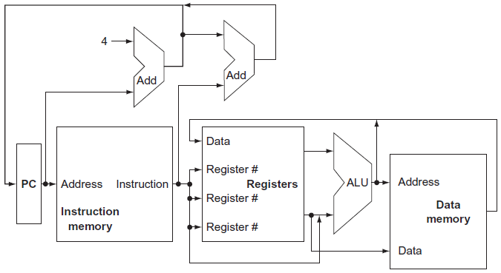
A basic MIPS implementation (Cont.)
An overview of the implementation (Cont.)
The abstract view of a MIPS implementation
Multiplexors, which select from among several inputs based on the setting of its control lines, are omitted
The control unit and control lines are omitted
Fig. 4.1 An abstract view of the implementation of the MIPS subset showing the major functional units and the major connections between them.

Slide 6
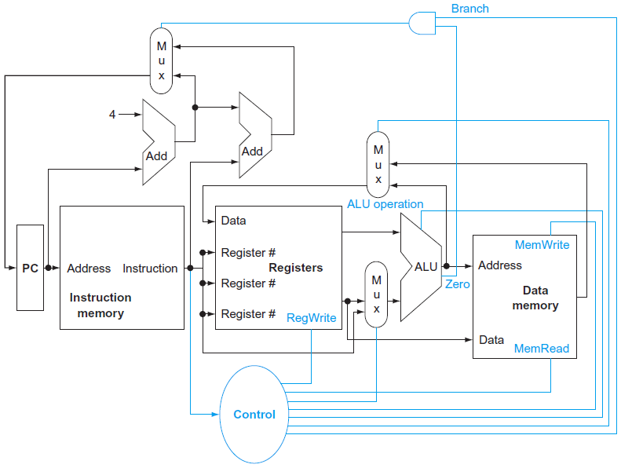
A basic MIPS implementation (Cont.)
An overview of the implementation (Cont.)
The datapath of the MIPS implementation
Three required multiplexors are added
A control unit and control lines for the major functional units are added
Fig. 4.2 The basic implementation of the MIPS subset, including the necessary multiplexors and control lines.

Slide 7
Logic Design Conventions
The datapath elements in the MIPS implementation
Logic element that operates on data values
Combinational logic (no internal storage)
The outputs depend only on the current inputs
Given the same input always produces the same output
Ex: ALU
Logic element that contains state (state element)
Sequential logic (internal storage)
The outputs depend on both inputs and contents of the internal state
At least two inputs and one output
Input: data value
Input: clock
Used to determine when the state element should be written
The state element can be read at any time
Output: the value written in an earlier clock cycle
Ex: instruction/data memory, register

Slide 8
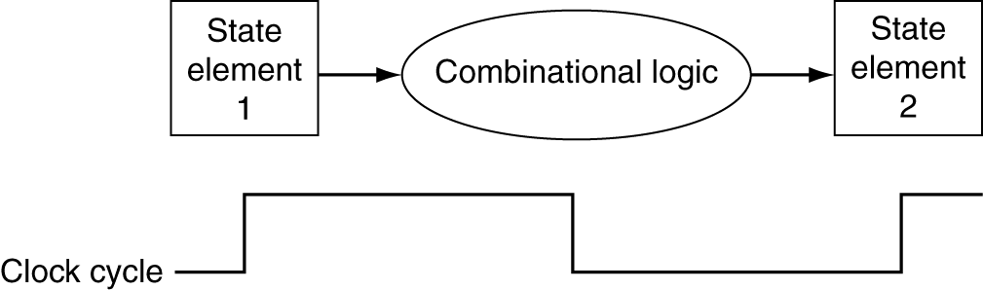
Clocking methodology
To define when signals can be read and written
If a signal is written and read at the same time, the value of the read will be unpredictable!
Edge-triggered
Any values stored in a state element are updated only on a clock edge
For a combinational logic
Inputs and outputs must be state elements
Inputs: values written in a previous clock cycle
Outputs: values can be used in a following clock cycle
All signals must propagate through the combinational logic in the time of one clock cycle
The time necessary for the signals to reach outputs defines the length of the clock cycle
Fig. 4.3 Combinational logic, state elements, and the clock are closely related.

Slide 9
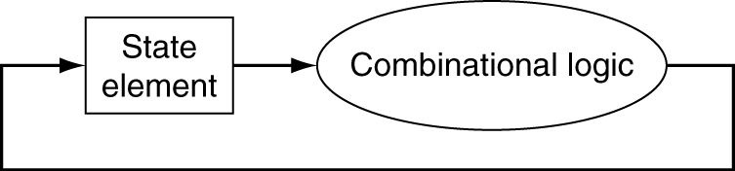
Clocking methodology (Cont.)
Edge-triggered (Cont.)
Control signal vs. Data signal
Control signal
Used for multiplexor selection or for directing the operation of a functional unit
The state element is changed only when the write control signal is asserted and a clock edge occurs
If a state element is written on every active clock edge, the control signal is often omitted
If a state element is not updated on every clock, then an explicit write control signal is required
Data signal
To contain information that is operated on by a functional unit
Terminologies
Asserted/deasserted: a signal is logically high/low
Assert/deassert: a signal should be driven logically high/low
To allow a state element to be read and written in the same clock cycle
The following steps are done in the same clock cycle
To read the contents of a register
To send the value through some combinational logic
To write the same register
No feedback within a single clock cycle

Slide 10
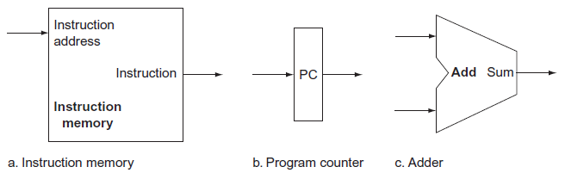
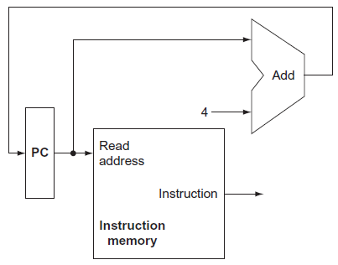
Building a Datapath
The datapath elements in the MIPS implementation
Elements used to fetch instructions and increment the PC
Instruction memory
A memory unit to store instruction of a program and supply instructions given an address
Program counter (PC)
A register holds the address of the current instruction
Adder
To increment the PC by 4 to the address of the next instruction
An ALU that the control always specifies an add operation
Fig. 4.6 A portion of the datapath used for fetching instructions and incrementing the program counter.
Fig. 4.5 Two state elements are needed to store and access instructions, and an adder is needed to compute the next instruction address.

Slide 11
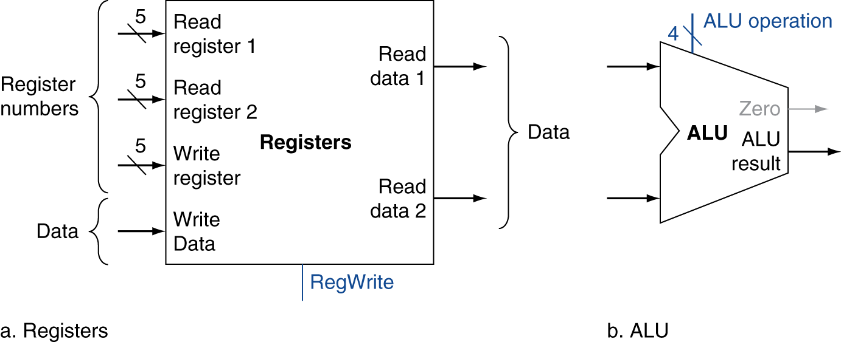
The datapath elements in the MIPS implementation (Cont.)
Register file
A collection of 32 32-bit general-purpose registers
Any register can be read or written by specifying its register number
Four inputs and two outputs in total
To read a data word
An input to specify the register number to be read (5 bits)
An output to carry the value been read
The register file always outputs the contents of whatever register numbers are on the Read register inputs
To write a data word
An input to specify the register number to be written
An input to supply the data to be written into the register
To occur at the clock edge and the write control signal is asserted
Fig. 4.7 The two elements needed to implement R-format ALU operations are the register file and the ALU.

Slide 12
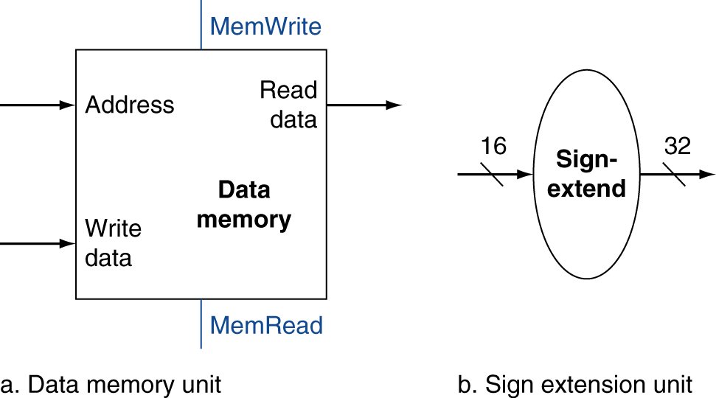
The datapath elements in the MIPS implementation (Cont.)
Arithmetic logic unit (ALU)
To take two 32-bit inputs and produce a 32-bit result
A 1-bit Zero signal to indicate the result is 0
4-bit control signals
Data memory
A state element to store data
Two inputs for the address and the write data
A single output for the read result
Separate read and write controls
To read the value of an invalid address can cause problems
Sign extension unit: 16 bits → 32 bits
To replicate the high-order sign bit of the original data item
Fig. 4.8 The two units needed to implement loads and stores, in addition to the register file and ALU, are the data memory unit and the sign extension unit.

Slide 13
For different classes of instruction
add/sub/and/or/sll $t1, $t2, $t3
Fetching instructions and incrementing the PC
Register file: to read operands in $t2 and $t3, to write result to $t1
ALU: to operate
lw/sw $t1, offset($t2)
Fetching instructions and incrementing the PC
Register file: to read the base register $t2, to write/read data to/from $t1
Sign extension: to sign-extend the 16-bit offset to a 32-bit signed value
ALU: to compute a memory address (base register $t2 + offset)
Data memory: to read/write data
beq $t1, $t2, offset
Fetching instructions and incrementing the PC
Register file: to read registers $t1 and $t2 for comparison
Sign extension: to sign-extend the 16-bit offset to a 32-bit signed value
Adder: to compute the branch target address (PC + offset)
Shifter: to left shift the (sign-extended) offset by 2

Slide 14
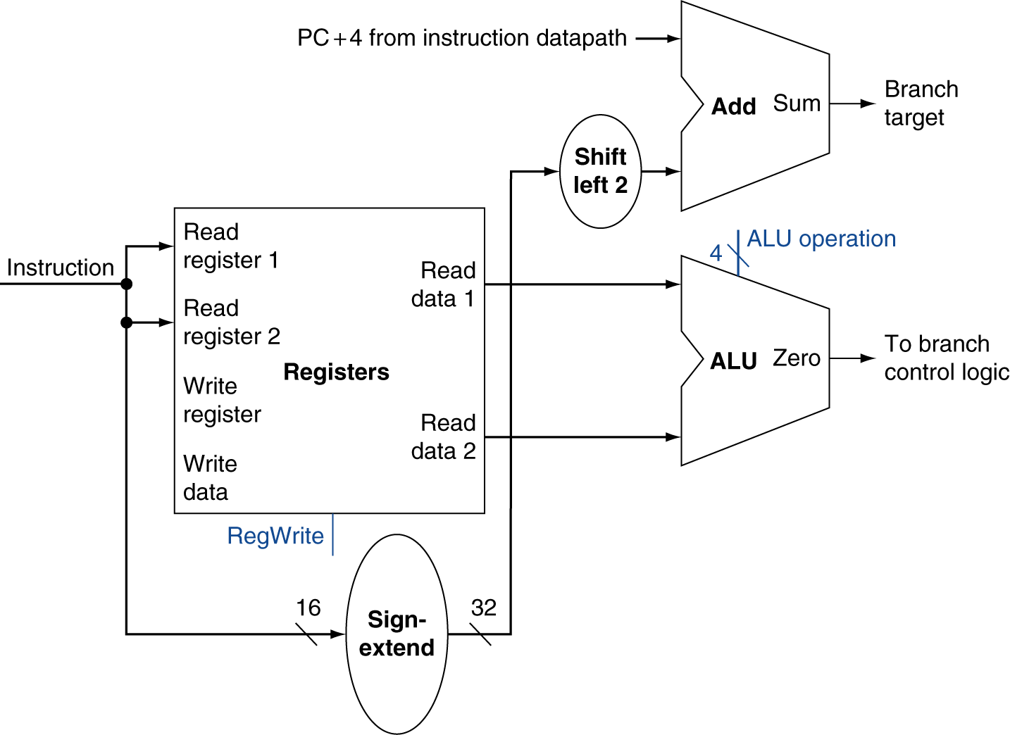
For different classes of instruction (Cont.)
beq $t1, $t2, offset (Cont.)
ALU: to compare contents of registers $t1 and $t2 by subtraction
Using the zero signal to indicate whether the operands are equal or not
Branch taken: Zero = 1 ⇒ new PC = branch target address
Branch not taken: Zero = 0 ⇒ new PC = PC
j offset
Fetching instructions and incrementing the PC
Shifter: to left shift the offset by 2 (26 bits → 28 bits)
To replace the lower 28 bits of PC
Fig. 4.9 The datapath for a branch uses the ALU to evaluate the branch condition and a separate adder to compute the branch target as the sum of the incremented PC and the sign-extended, lower 16 bits of the instruction, shifted left 2 bits.

Slide 15
Creating a single datapath
To execute all instructions in one clock cycle
No datapath resource can be used more than once per instruction
Any element needed more than once must be duplicated
Separate instruction and data memories
Some elements can be shared by different instruction flows
Using a multiplexor and control signal to select among the multiple inputs
Example: building a datapath
To build a datapath for memory references and R-type instructions using a single register file and a single ALU
Using the ALU
R-type instruction: inputs coming from two registers
Memory reference: the 2nd input is the sign-extended 16-bit offset
⇒ A multiplexor is needed for the 2nd ALU input
The value stored into a destination register
R-type instruction: from the ALU
Memory reference: from the memory (for a load)
⇒ A multiplexor is needed for the data stored into the register file

Slide 16
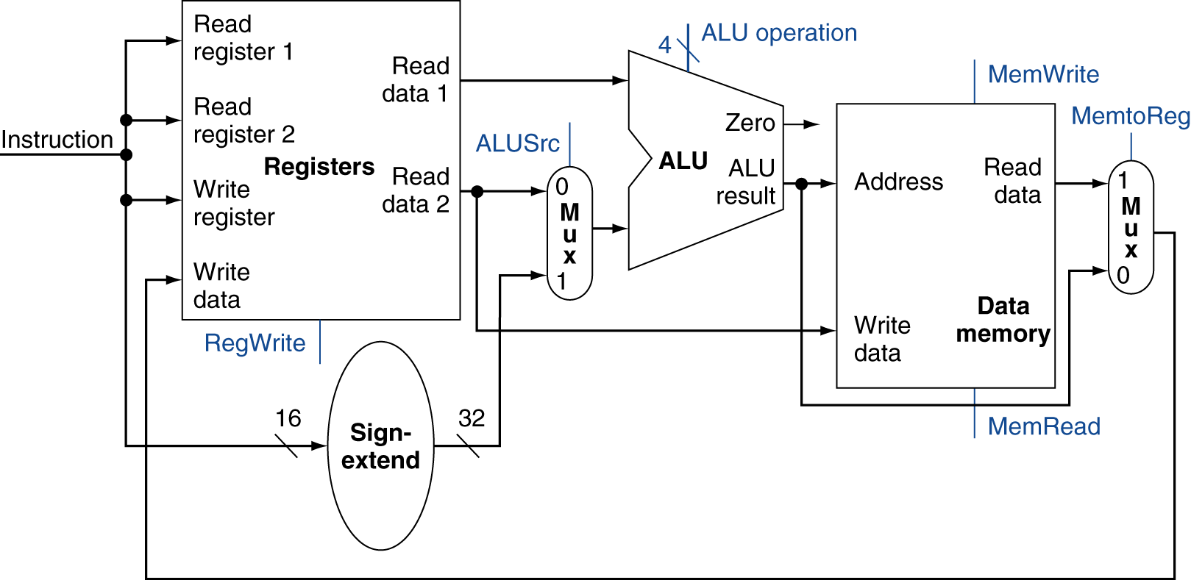
Creating a single datapath (Cont.)
Example: building a datapath (Cont.)
Fig. 4.10 The datapath for the memory instructions and the R-type instructions.

Slide 17
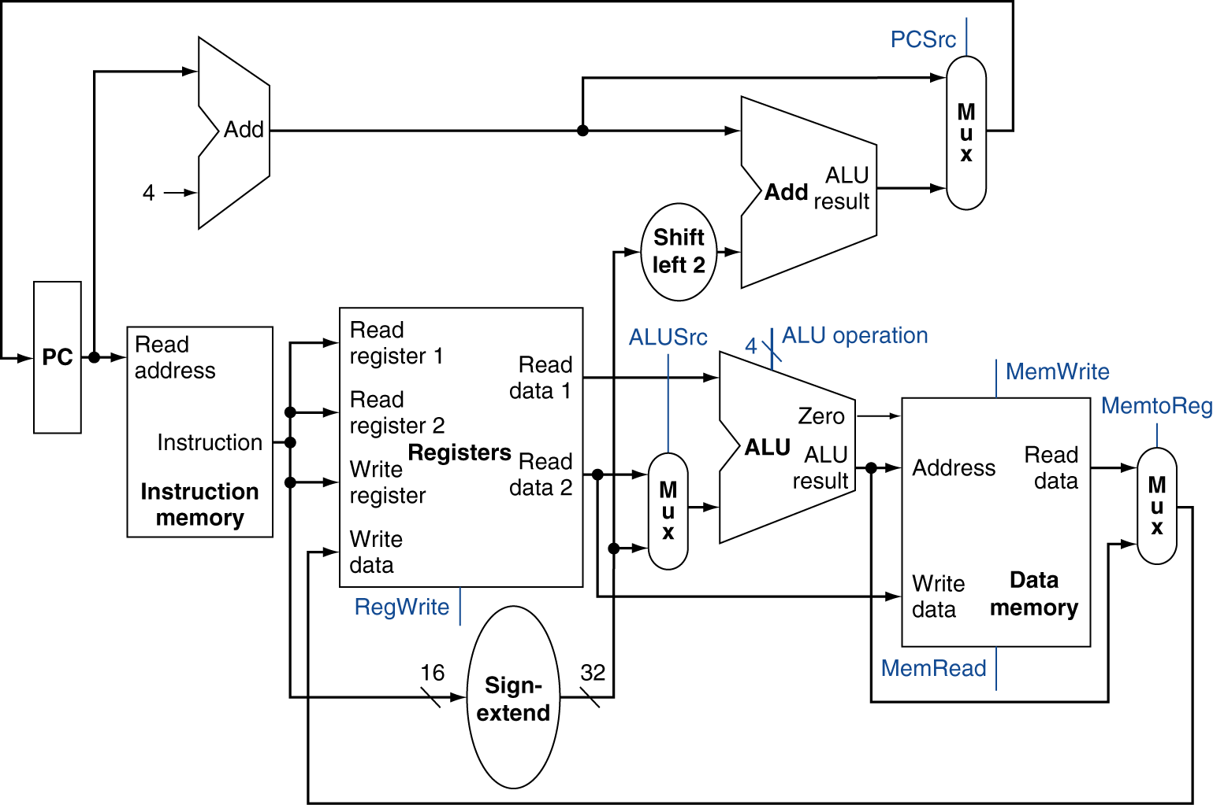
Creating a single datapath (Cont.)
To combine all the pieces to make a simple datapath
A multiplexor is required to select either the PC + 4 or the branch target address to be written into the PC
A control unit is added to take inputs and generate
A write signal for each state element
The selector control for each multiplexor
The ALU control
Fig. 4.11 The simple datapath for the MIPS architecture combines the elements required by different instruction classes.

Slide 18
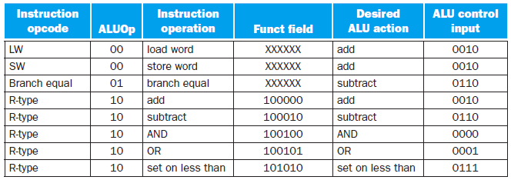
A Simple Implementation Scheme
The ALU control
The ALU has 4 control inputs but only 6 combinations are used
A small ALU control unit to generate the 4-bit ALU control input
Inputs: the funct field of the instruction and a 2-bit ALUOp
ALUOp = 00: addition for lw/sw
ALUOp = 01: subtraction for beq
ALUOp = 10: for R-type instructions, determined by the operation encoded in the funct field
Output: a 4-bit signal that directly controls the ALU
ALU control lines | Function
0000 | AND
0001 | OR
0010 | add
0110 | subtract
0111 | slt
1100 | NOR

Slide 19
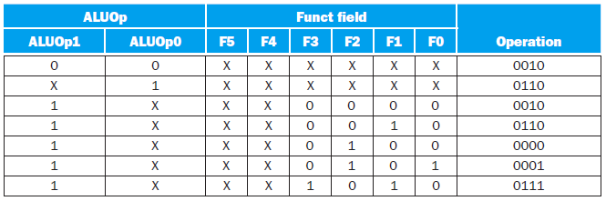
The ALU control (Cont.)
Multiple levels of decoding
The main control unit generates the ALUOp bits
ALUOp bits are used as input to the ALU control unit that generate the actual signals to control the ALU unit
Can reduce the size of the main control unit
Potentially increase the speed of the control unit
The speed of the control unit is often critical to clock cycle time
To implement the ALU control unit: truth table
Fig. 4.13 The truth table for the three ALU control bits (called Operation).

Slide 20
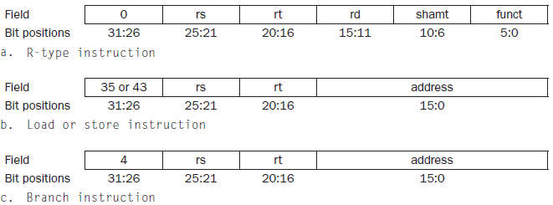
Designing the main control unit
Observations about instruction formats
op field (opcode) in bits 31:26
To denote the operation and format of an instruction (Op [5:0])
rs and rt fields at positions 25:21 and 20:16
To specify the two registers to be read, for R-type, beq, sw instructions
The base register for lw and sw is in bits 25:21 (rs)
The 16-bit offset for beq, lw, and sw is in positions 15:0
Destination register
For lw is in bits 20:16 (rt) For R-type is in bits 15:11 (rd)
⇒ A multiplexor is needed to select which field of the instruction is used to indicate the register number to be written
R
R
W
R
W/R
Fig. 4.14 The three instruction classes (R-type, load and store, and branch use two different instruction formats.
R
R

Slide 21
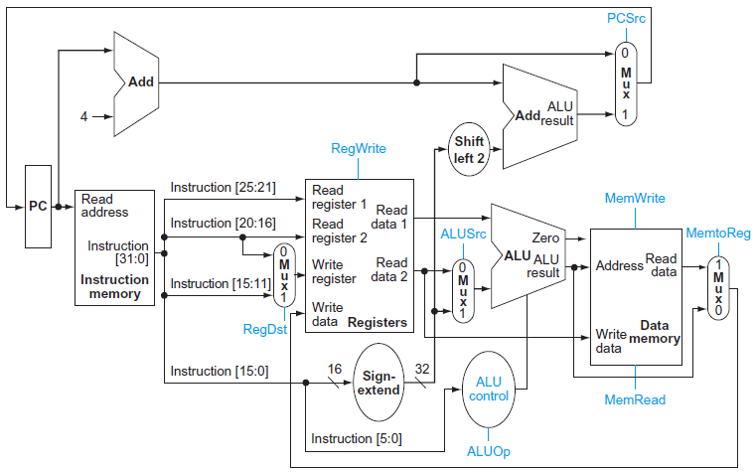
Designing the main control unit (Cont.)
The datapath with multiplexors and control signals
ALU control unit, 4 multiplexors, 7 single-bit control lines, and a 2-bit ALUOp control signal
All the multiplexors have two inputs and require a single control line
Fig. 4.15 The datapath of Figure 4.11 with all necessary multiplexors and all control lines identified.

Slide 22
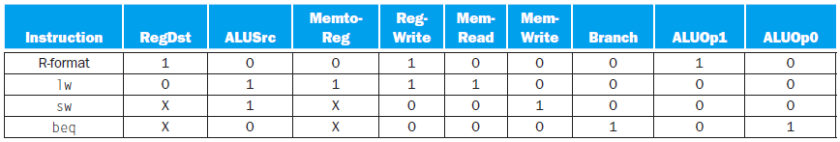
Designing the main control unit (Cont.)
The datapath with multiplexors and control signals (Cont.)
The function of each of the control signals
All but PCSrc can be set based solely on the opcode
PCSrc should be asserted if the instruction is beq and the Zero output of the ALU is asserted (PCSrc = Branch AND Zero)
Signal name | Effect when deasserted (0) | Effect when asserted (1)
RegDst | The register destination number for the Write register comes from the rt field (bits 20:16) | The register destination number for the Write register comes from the rd field (bits 15:11)
RegWrite | None | The register on the Write register input is written with the value on the Write data input
ALUSrc | The second ALU operand comes from the second register file output (Read data 2) | The second ALU operand is the sign-extended, lower 16 bits of the instruction
PCSrc | The PC is replaced by the output of the adder that computes the value of PC + 4 | The PC is replaced by the output of the adder that computes the branch target
MemRead | None | Data memory contents designated by the address input are put on the Read data output
MemWrite | None | Data memory contents designated by the address input are replaced by the value on the Write data input
MemtoReg | The value fed to the register Write data input comes from the ALU | The value fed to the register Write data input comes from the data memory
lw
R-type
sw, beq
lw, R-type
R-type, beq
lw, sw
R-type, lw, sw, beq untaken
beq taken
R-type, sw, beq
lw
R-type, lw, beq
sw
Fig. 4.16 The effect of each of the seven control signals.
R-type
lw
Fig. 4.18 The setting of the control lines is completely determined by the opcode fields of the instruction.

Slide 23
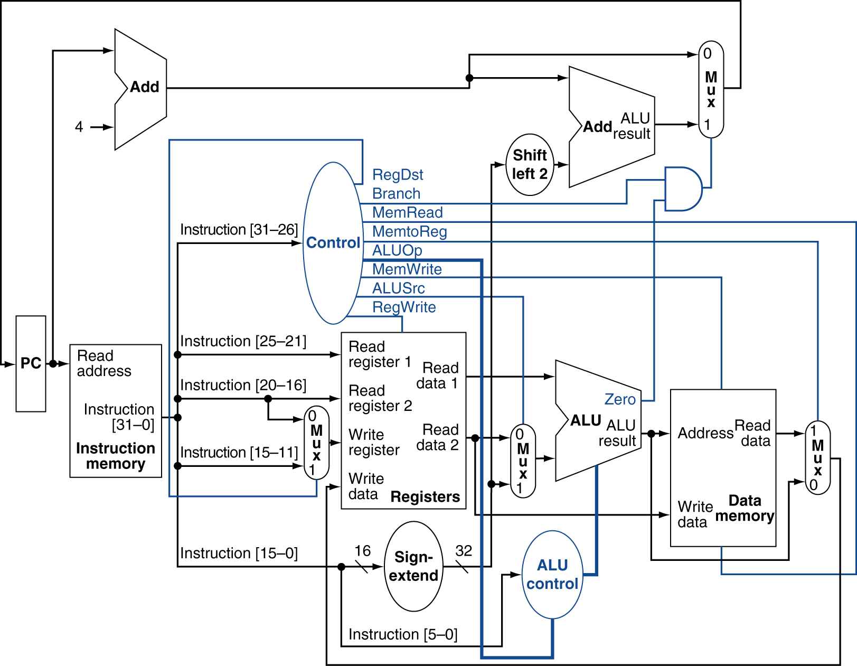
Designing the main control unit (Cont.)
The datapath with multiplexors and control signals (Cont.)
All 9 control signals can now be set on the basis of opcode to the control unit
_{PCSrc}
Fig. 4.17 The simple datapath with the control unit.

Slide 24
Designing the main control unit (Cont.)
Operation of the datapath
R-type instruction: add $t1, $t2, $t3
The instruction is fetched, PC is incremented
$t2 and $t3 are read from the register file; main control unit sets control lines
The ALU operates, using the funct field of the instruction (bits 5:0) to generate the ALU function
The result from the ALU is written into the register file (bits 15:11)
lw $t1, offset($t2)
The instruction is fetched, PC is incremented
$t2 is read from the register file; main control unit sets control lines
The ALU performs addition to compute the address ($t2 + sign-extended offset)
To read the data memory
The data from the memory unit is written into the register file (bits 20:16)
beq $t1, $t2, offset
The instruction is fetched, PC is incremented
$t2 and $t3 are read from the register file; main control unit sets control lines
The ALU performs subtraction for equality comparison; the adder computes the branch target address (PC + sign-extended offset shifted left by 2)
The Zero result from the ALU is used to decide which adder result to store into the PC

Slide 25
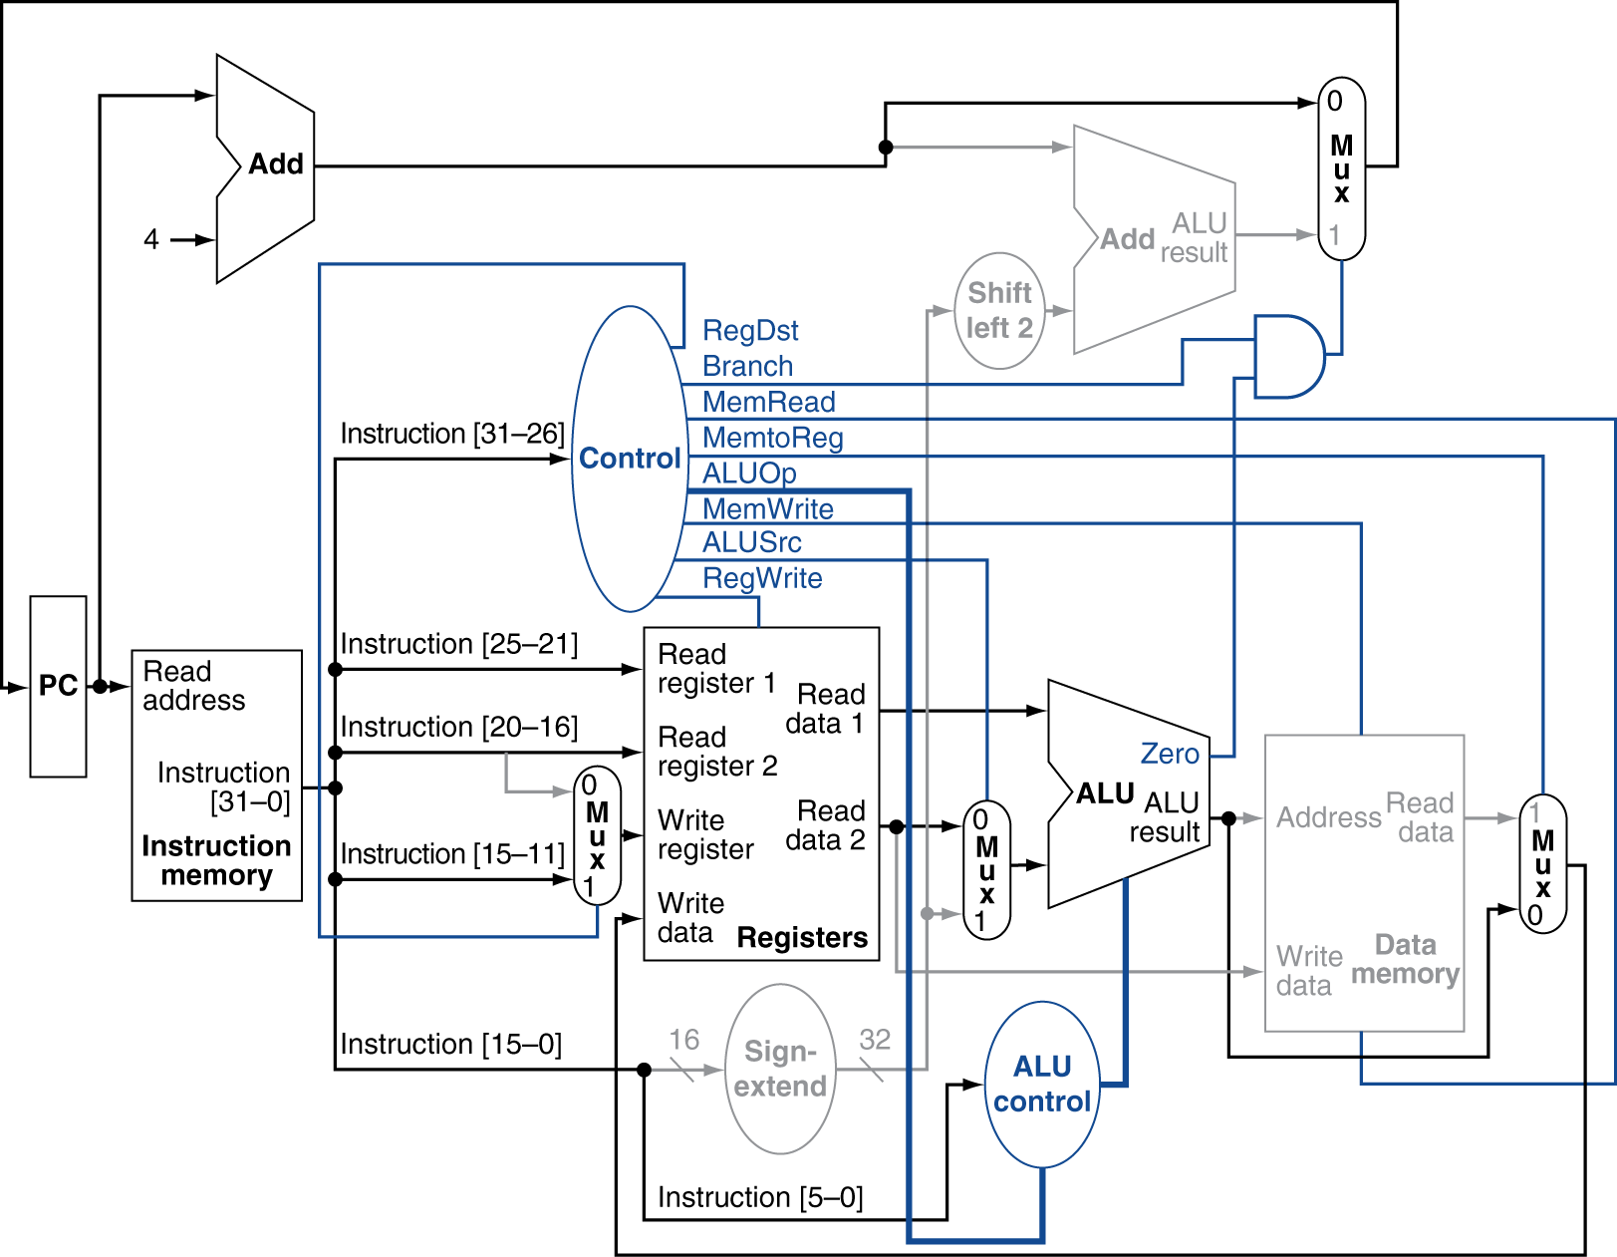
Fig. 4.19 The datapath in operation for an R-type instruction such as add $t1, $t2, $t3.

Slide 26
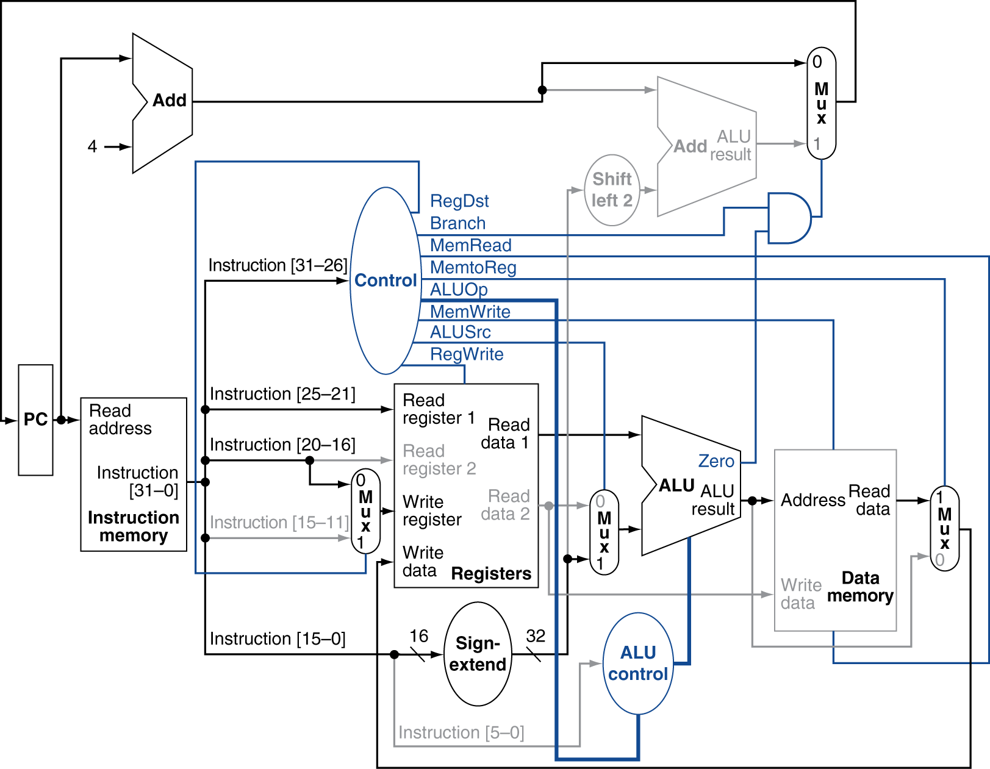
Fig. 4.20 The datapath in operation for a lw instruction.

Slide 27
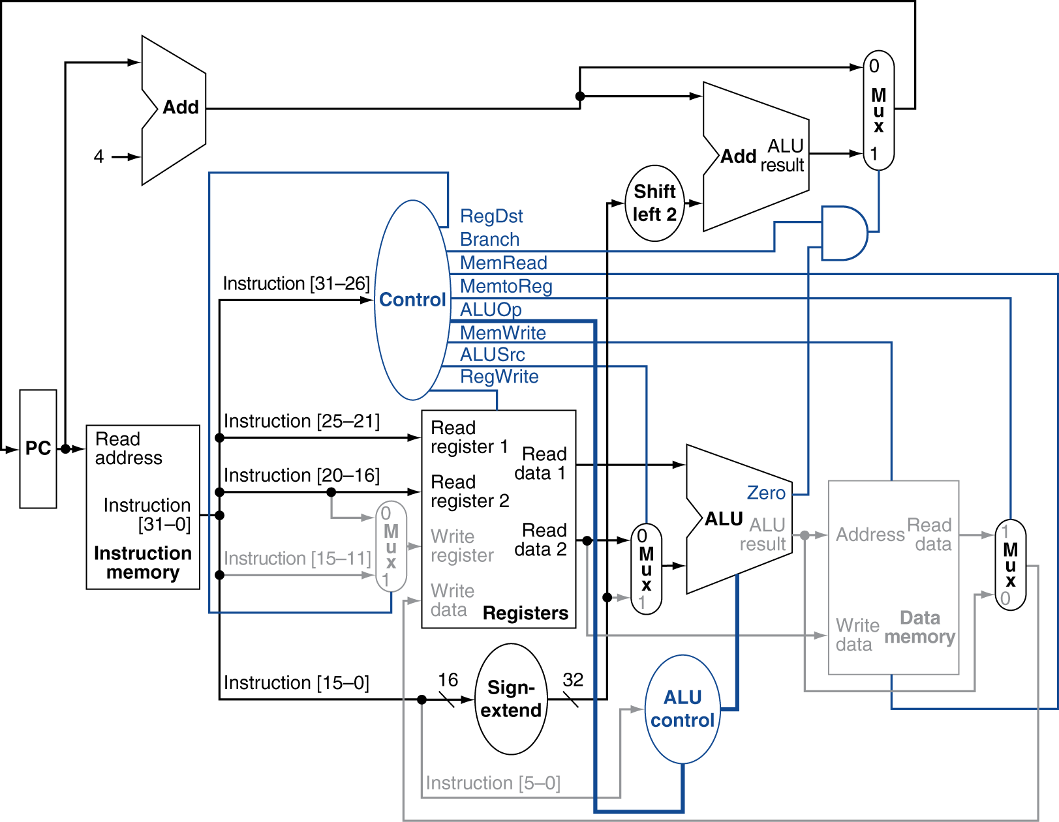
Fig. 4.21 The datapath in operation for a beq instruction.

Slide 28
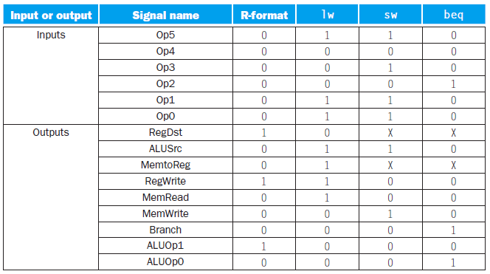
Designing the main control unit (Cont.)
Finalizing control
Truth table of the main control unit
Input: the 6-bit opcode field Op [5:0]
Output: 9 control lines
Fig. 4.22 The control function for the simple single-cycle implementation is completely specified by this truth table.

Slide 29
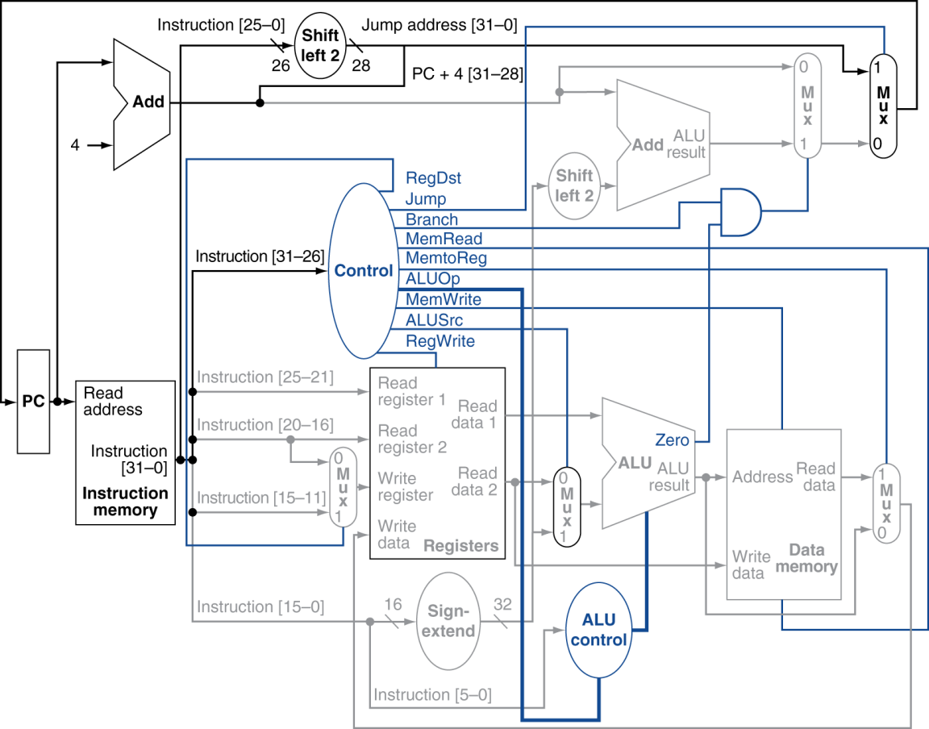
Designing the main control unit (Cont.)
Finalizing control (Cont.)
Example: implementing jumps
Jump address
[31:28] of the current PC + 4, 26-bit immediate filed of the jump instruction, bits 00₂
An additional control signal Jump
Fig. 4.24 The simple control and datapath are extended to handle the jump instruction.

Slide 30
Why a single-cycle implementation is not used today
The single-cycle design is inefficient
CPI = 1
The clock cycle is determined by the longest possible path in the machine
Example: performance of single-cycle machines
Problem
Operation times
Memory units 200 ps, ALU & adder 100 ps, register file read/write 50 ps
Instruction mix
25% loads, 10% stores, 45% ALU instruction, 15% branches, 5% jumps
Implementation 1
Every instruction operates in 1 clock cycle of a fixed length
Implementation 2
Every instruction executes in 1 clock cycle using a variable-length clock
To compare the performance between implementations 1 and 2
Instruction class | Functional units used by the instruction class |  |  |  |  | Total
R-type | Instruction fetch | Register access | ALU | Register access |  | 400 ps
Load word | Instruction fetch | Register access | ALU | Memory access | Register access | 600 ps
Store word | Instruction fetch | Register access | ALU | Memory access |  | 550 ps
Branch | Instruction fetch | Register access | ALU |  |  | 350 ps
Jump | Instruction fetch |  |  |  |  | 200 ps

Slide 31
Why a single-cycle implementation is not used today (Cont.)
Example: performance of single-cycle machines (Cont.)
Solution
To compute the critical path for different instruction classes
Clock cycle of implementation 1: 600 ps
Clock cycle of implementation 2:
600 × 25% + 550 × 10% + 400 × 45% + 350 × 15% + 200 × 5% = 447.5 ps
Performance ratio:
Using the single-cycle design with a fixed clock cycle
Acceptable for small and simple instruction set
The clock cycle is equal to the worst-case delay for all instructions
Each functional unit can be used only once per clock
⇒ Multicycle implementation
Shorter clock cycle
Each instruction requires multiple clock cycles to complete

Slide 32
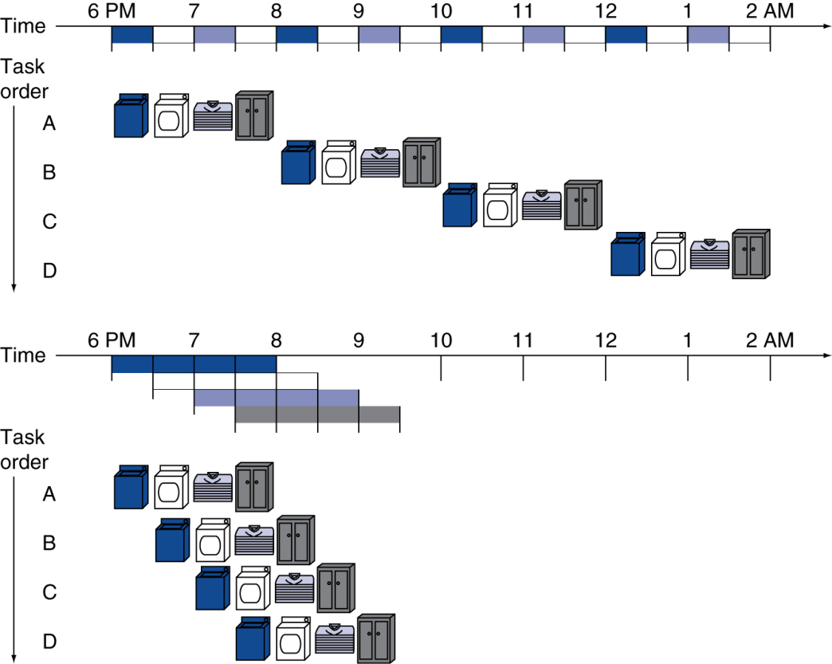
An Overview of Pipelining
Pipeline
An implementation technique in which multiple instructions are overlapped in execution
Fig. 4.25 The laundry analogy for pipelining.

Slide 33
Pipeline (Cont.)
Observations of the laundry example
Pipelining improves throughput without improving the time to complete a single task
If all stages take about the same amount of time and there is enough work to do
⇒ The speedup is equal to the number of stages in the pipeline
The pipeline is not completely full at the beginning and end of the workload
⇒ This start-up and wind-down affects performance when the number of tasks is not large compared to the number of stages in the pipeline
Example: single-cycle vs. pipelined performance
Problem
8 instructions: lw, sw, add, sub, and, or, slt, beq
Memory access: 200 ps ALU operation: 200 ps Register file R/W: 100 ps
To compare the average time between instructions of a single-cycle implementation to a pipelined implementation
Solution
The pipeline execution clock cycle must have the worst-case clock cycle of 200 ps
To execute three lw instructions
The time between the 1st and 4th instruction: 2400 ps vs. 600 ps
The total execution time: 2400 ps vs. 1400 ps

Slide 34
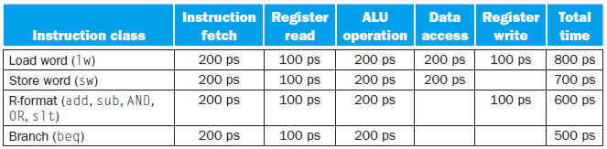
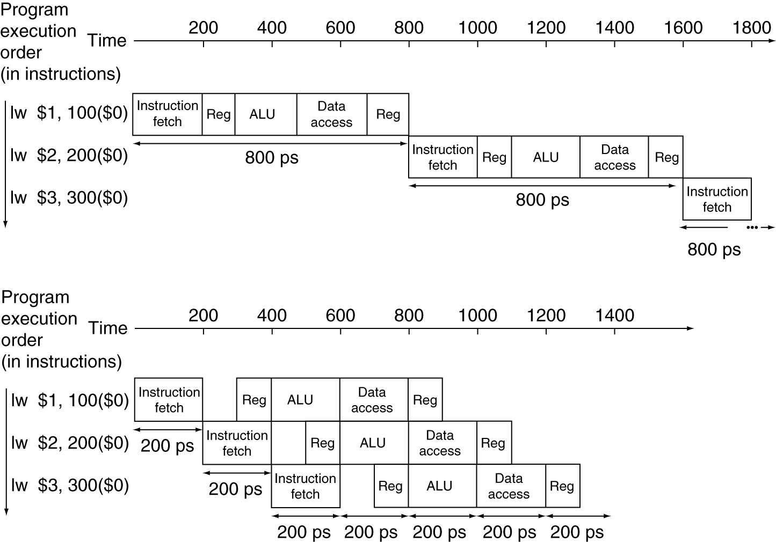
Fig. 4.26 Total time for each instruction calculated from the time for each component.
2400 ps
1400 ps
Fig. 4.27 Single-cycle, nonpipelined execution in top vs. pipelined execution in bottom.

Slide 35
Pipeline (Cont.)
Pipelining speed-up discussion
Assuming ideal conditions: the stages are perfectly balanced
Under ideal conditions and with a large number of instructions
⇒ The speedup is approximately equal to the number of pipe stages
In previous example: 800 ps should be improved to 160 ps
Pipelining involves some overhead
The time per instruction in the pipelined processor will exceed the minimum possible
The speed-up will be less than the number of pipeline stages
In the previous example: 2400 ps → 1400 ps
3 lw instructions: speedup = 2400/1400 ≈ 1.71
1,000,003 lw instructions: speedup = 800,002,400/200,001,400 ≈ 4
Summary
Pipelining improves performance by increasing instruction throughput, as opposed to decreasing the execution time of an individual instruction
Instruction throughput is the important metric because real programs execute billions of instructions

Slide 36
Designing instruction sets for pipelining
MIPS instruction set is designed for pipelined execution
Characteristics of MIPS instruction set
All MIPS instructions are the same length
Easier to fetch and decode instructions
Intel x86 instruction set
Instructions vary from 1~15 bytes
To translate x86 instructions into simple micro-operation
To pipeline the micro-operations rather than the native x86 instructions
MIPS has only a few instruction formats, with the source register fields being located at the same place in each instruction
The 2nd stage can begin reading the register file at the same time that the hardware is determining what type of instruction was fetched
Memory operands only appear in loads and stores
We can use the execute stage to calculate the memory address and then access memory in the following stage
Operands must be aligned in memory
A single data transfer instruction will not require two data memory accesses
The requested data can be transferred in a single pipeline stage

Slide 37
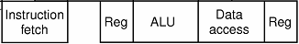
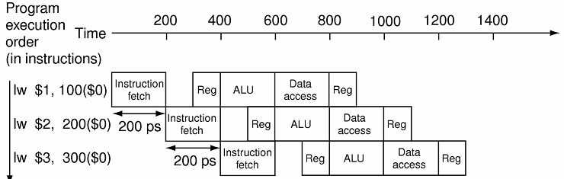
Pipeline hazards
Hazards are situations in pipelining when the next instruction cannot execute in the following clock cycle
Structural hazards
The hardware cannot support the combination of instructions that we want to execute in the same clock cycle
Example
Suppose we had a single memory instead of two memories
In the same clock cycle the 1st instruction is accessing data from memory while the 4th instruction is fetching an instruction from the same memory
lw $4, 400($0)
structural hazards

Slide 38
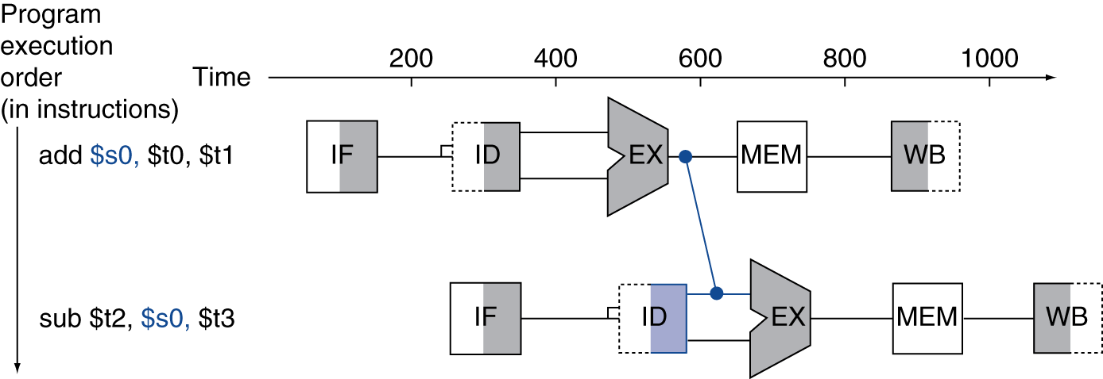
Pipeline hazards (Cont.)
Data hazards
The pipeline must be stalled because one step must wait for another to complete
Arising from the dependence of one instruction on an earlier one that is still in the pipeline
add $s0, $t0, $t1
sub $t2, $s0, $t3 ⇒ 3 clock cycles are wasted in the pipeline
Compiler can remove data hazards but its results is not satisfactory
These dependences happen too often
The delay is too long to expect the compiler to rescue us from this dilemma
Solution: forwarding/bypassing
Adding extra hardware to retrieve the missing item early from the internal resource
Forwarding paths are valid only if the destination stage is later in time than the source stage
Fig. 4.29 Graphical representation of forwarding.

Slide 39
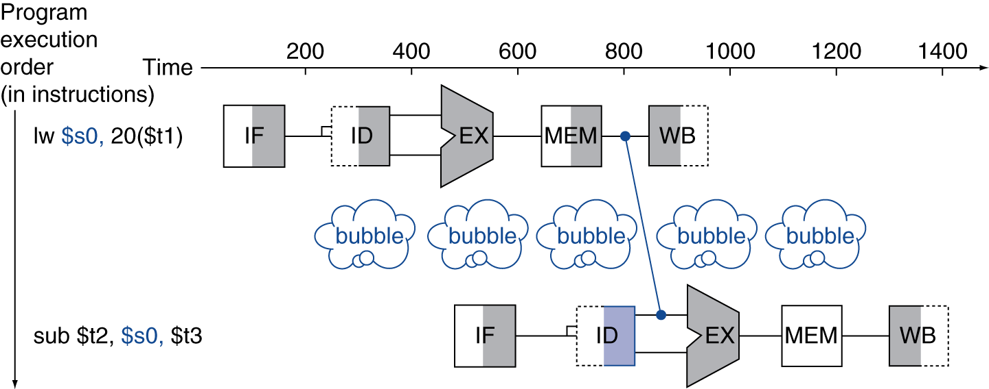
Pipeline hazards (Cont.)
Data hazards (Cont.)
Solution: forwarding/bypassing (Cont.)
Forwarding cannot prevent all pipeline stalls
Load-use data hazard
The data being loaded by a lw instruction has not yet become available when it is needed by another instruction
Pipeline stall (bubble)
A stall initiated in order to resolve a hazard
Fig. 4.30 We need a stall even with forwarding when an R-format instruction following a load tries to use the data.

Slide 40
Pipeline hazards (Cont.)
Data hazards (Cont.)
Example: reordering code to avoid pipeline stalls
a = b + e; c = b + f;
Original
lw $t1, 0($t0) # load b
lw $t2, 4($t0) # load e
add $t3, $t1, $t2
sw $t3, 12($t0)
lw $t4, 8($t0) # load f
add $t5, $t1, $t4
sw $t5, 16($t0)
 | 1 | 2 | 3 | 4 | 5 | 6 | 7 | 8 | 9 | 10 | 11 | 12 | 13
lw | IF | ID | EX | MEM | WB
lw |  | IF | ID | EX | MEM | WB
add |  |  |  | IF | ID | EX | MEM | WB
sw |  |  |  |  | IF | ID | EX | MEM | WB
lw |  |  |  |  |  | IF | ID | EX | MEM | WB
add |  |  |  |  |  |  |  | IF | ID | EX | MEM | WB
sw |  |  |  |  |  |  |  |  | IF | ID | EX | MEM | WB
b
bubble
e
bubble
bubble
bubble
f
bubble
bubble

Slide 41
Pipeline hazards (Cont.)
Data hazards (Cont.)
Example: reordering code to avoid pipeline stalls (Cont.)
Reordering
lw $t1, 0($t0) # load b
lw $t2, 4($t0) # load e
lw $t4, 8($t0) # load f
add $t3, $t1, $t2
sw $t3, 12($t0)
add $t5, $t1, $t4
sw $t5, 16($t0)
Each MIPS instruction writes at most one result and does this in the last stage of the pipeline
Forwarding is harder if
There are multiple results to forward per instruction
There is a need to write a result early in instruction execution
 | 1 | 2 | 3 | 4 | 5 | 6 | 7 | 8 | 9 | 10 | 11
lw | IF | ID | EX | MEM | WB
lw |  | IF | ID | EX | MEM | WB
lw |  |  | IF | ID | EX | MEM | WB
add |  |  |  | IF | ID | EX | MEM | WB
sw |  |  |  |  | IF | ID | EX | MEM | WB
add |  |  |  |  |  | IF | ID | EX | MEM | WB
sw |  |  |  |  |  |  | IF | ID | EX | MEM | WB
b
e
f

Slide 42
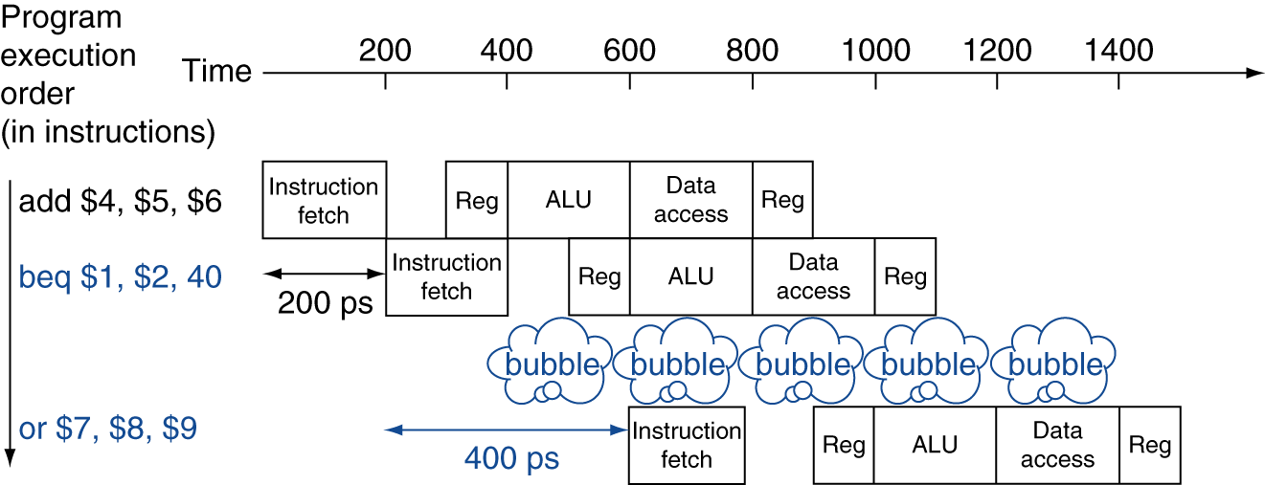
Pipeline hazards (Cont.)
Control hazards (branch hazard)
Arising from the need to make a decision based on the results of one instruction while others are executing ⇒ branch instruction
The instruction that was fetched is not the one that is needed
The flow of instruction addresses is not what the pipeline expected
Solution 1: stall
To stall immediately after fetching a branch, and waiting until the pipeline determines the outcome of the branch
Conservative option, slow
Example
Suppose the branch can be resolve in the 2nd stage
If the branch cannot be resolved in the 2nd stage, we will see an even larger slowdown
Fig. 4.31 Pipeline showing stalling on every conditional branch as solution to control hazards.

Slide 43
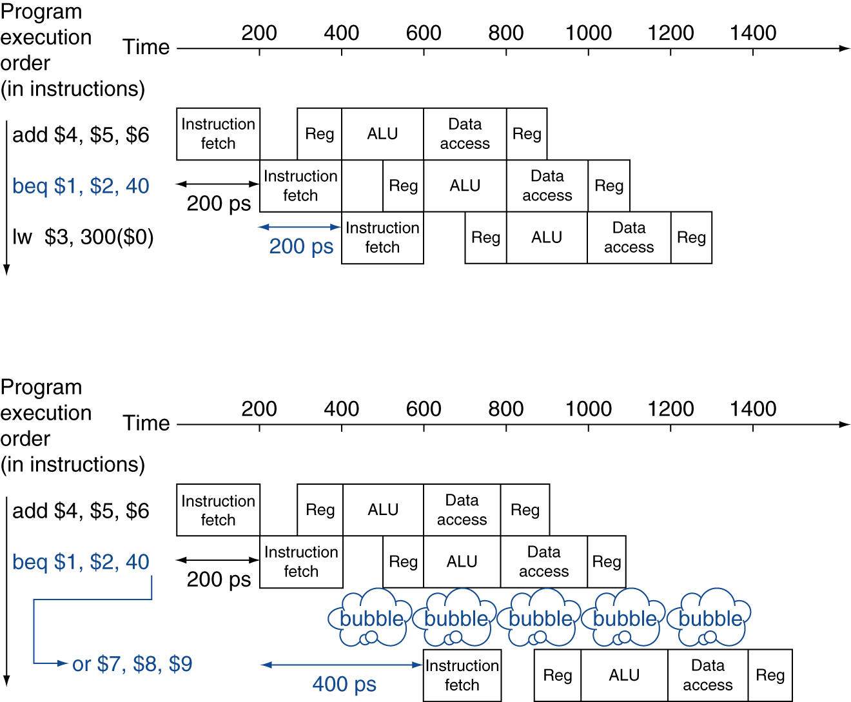
Pipeline hazards (Cont.)
Control hazards (branch hazard) (Cont.)
Solution 2: prediction
Simple approach: always predict that branches will be untaken
Untaken: pipeline proceeds at full speed
Taken: pipeline stall
Sophisticated version: branch prediction
Fig. 4.32 Predicting that branches are not taken as a solution to control hazard.

Slide 44
Pipeline hazards (Cont.)
Control hazards (branch hazard) (Cont.)
Branch prediction
To assume a given outcome for the branch and proceed from that assumption rather than waiting to ascertain the actual outcome
Some branches predicted as taken and some as untaken
Dynamic hardware predictor
Making their guess depending on the behavior of each branch
May change predictions for a branch over the life of a program
When the guess is wrong
To ensure the instructions following the wrongly guessed branch have no effect
To restart the pipeline from the proper branch address
Pipeline overview summary
Pipelining is a technique
To exploit parallelism among instructions in a sequential instruction stream
To increase the number of simultaneously executing instructions
To increase the rate at which instructions are started and completed
To improve instruction throughput rather than individual instruction execution time or latency
Invisible to programmer

Slide 45
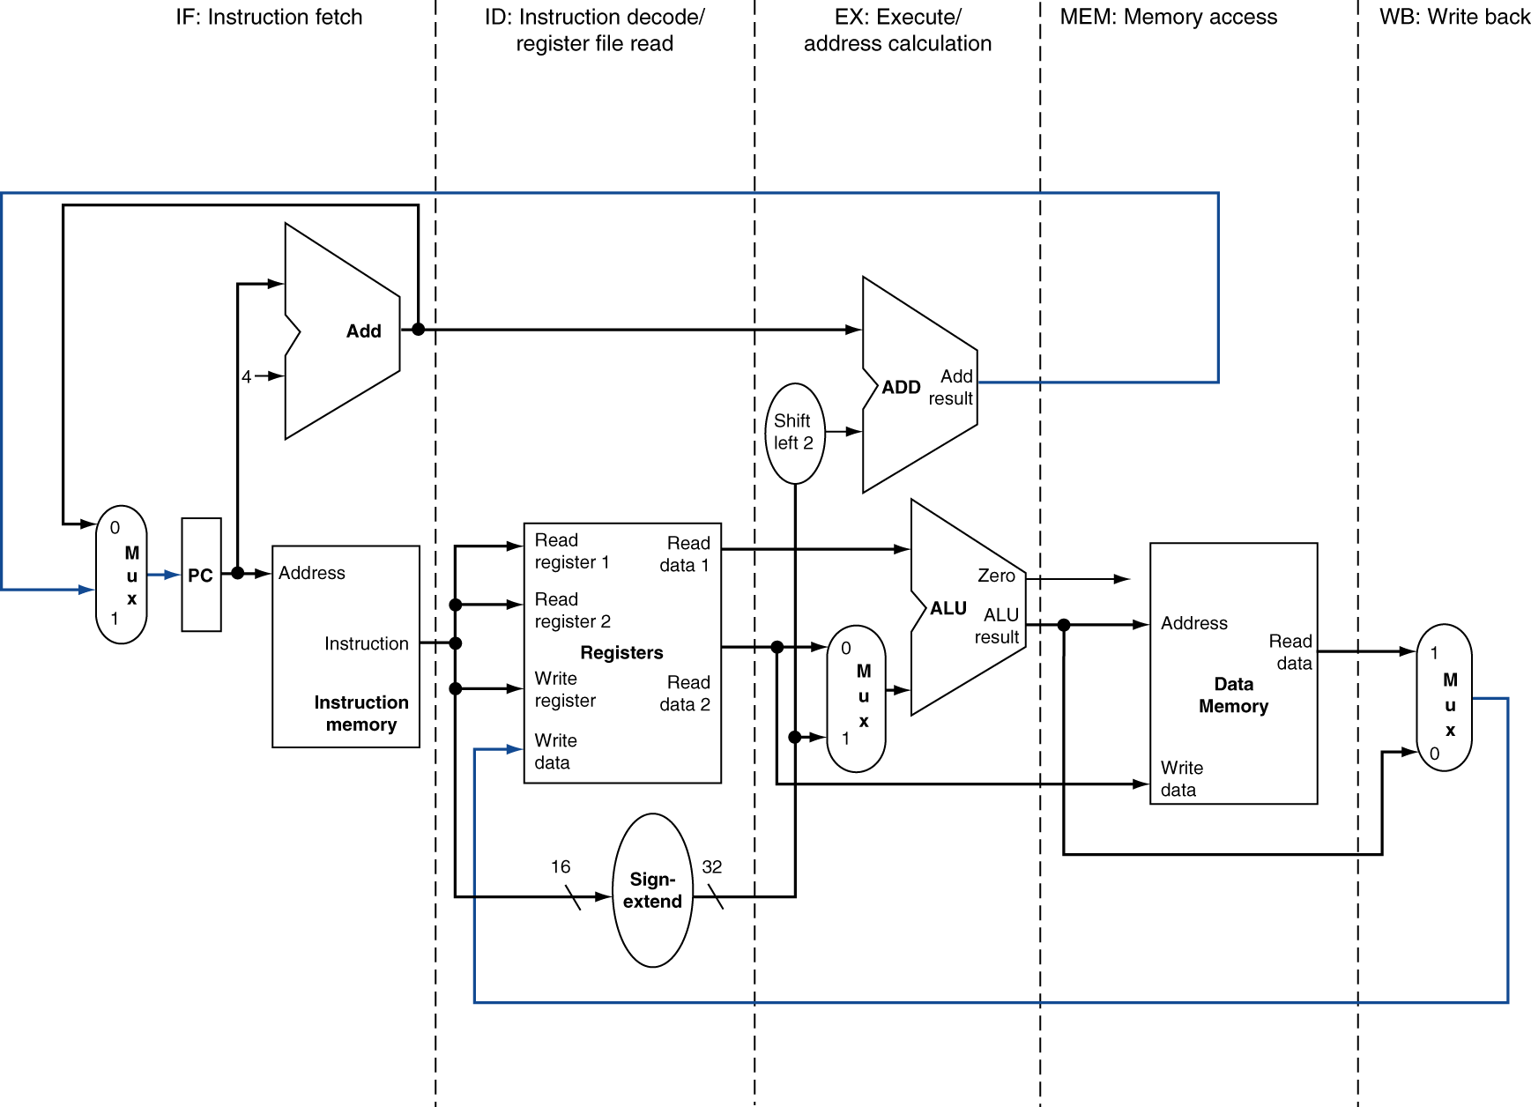
Pipelined Datapath and Control
Pipelined datapath
5 stages: IF, ID, EX, MEM, WB
Up to 5 instructions will be in execution during any single clock cycle
Fig. 4.33 The single-cycle datapath (similar to Fig. 4.17).

Slide 46
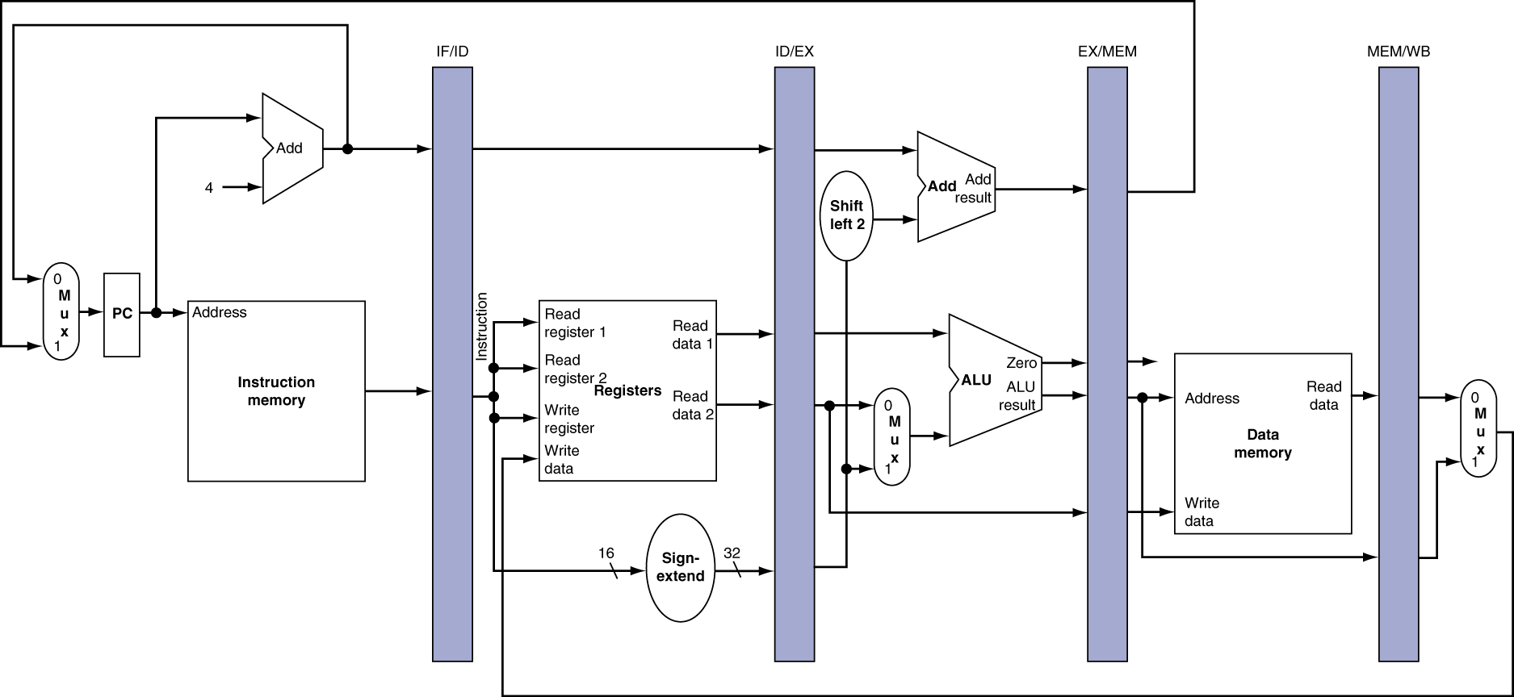
Pipeline datapath (Cont.)
Pipeline register
To retain the value of an instruction for its other four stages
All instructions advance during each clock cycle from one pipeline register to the next
The registers are named for the two stages separated by that register
PC can be thought of as a pipeline register
PC is part of the visible architectural state
Fig. 4.35 The pipelined version of the datapath in Fig. 4.33.

Slide 47
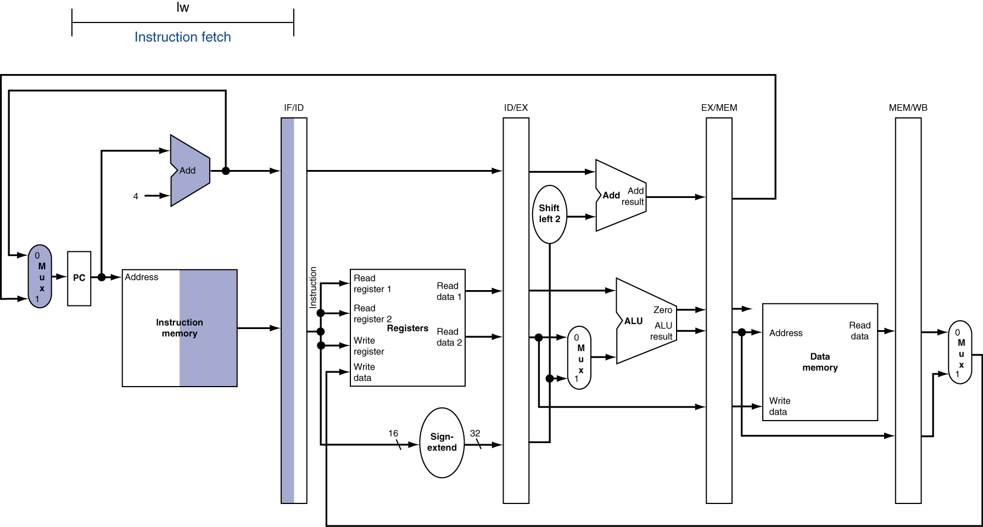
Pipeline datapath (Cont.)
Ex: lw goes through the 5 stages of pipelined execution
Highlight of registers or memory
Right half: read Left half: write
Instruction fetch (IF)
To read the instruction using the address in the PC and place in the IF/ID
To increment PC by 4, save to PC and IF/ID

Slide 48
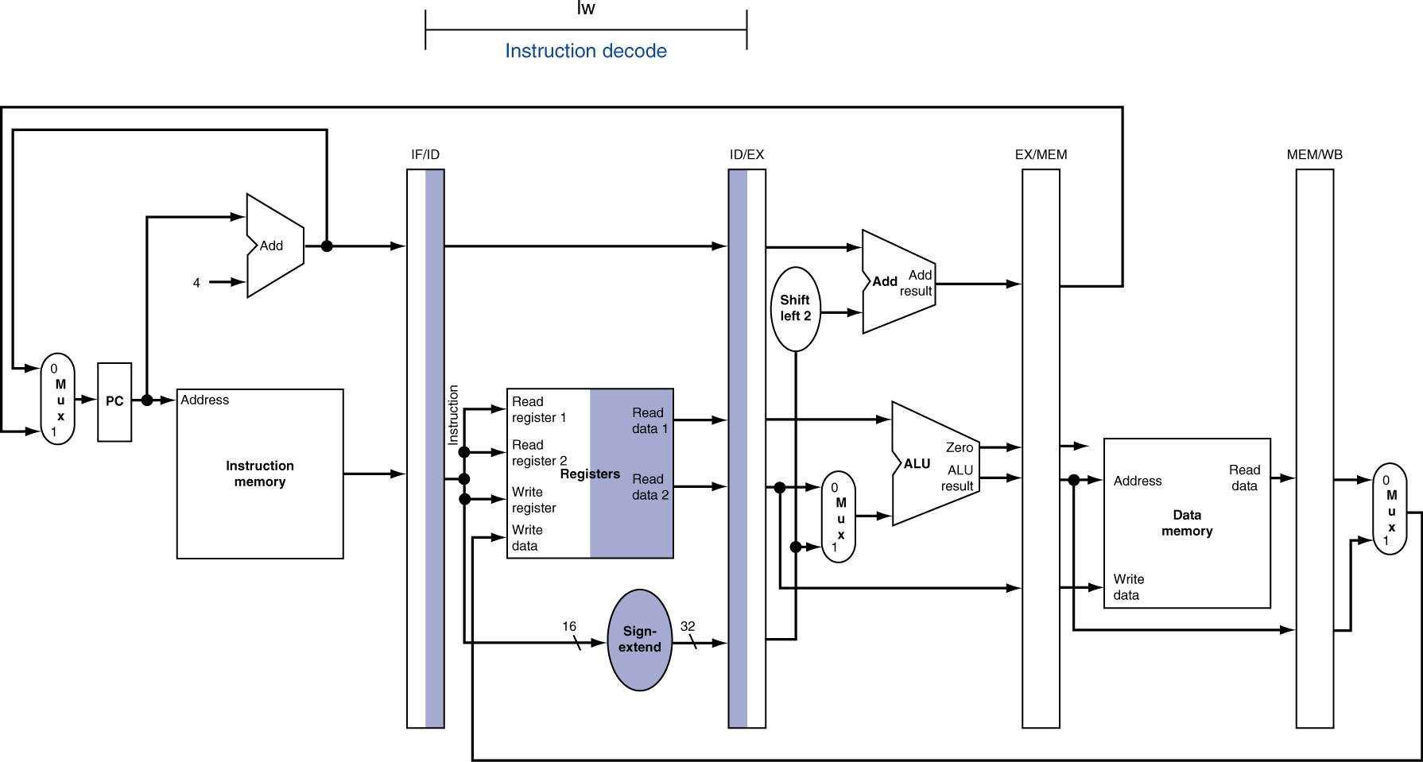
Pipeline datapath (Cont.)
Ex: lw goes through the 5 stages of pipelined execution (Cont.)
Instruction decode and register file read (ID)
The 16-bit immediate field of the instruction supplied from IF/ID is sign-extended to 32 bit
Register numbers supplied from IF/ID is used to read two registers
All above three values and PC are placed in the ID/EX

Slide 49
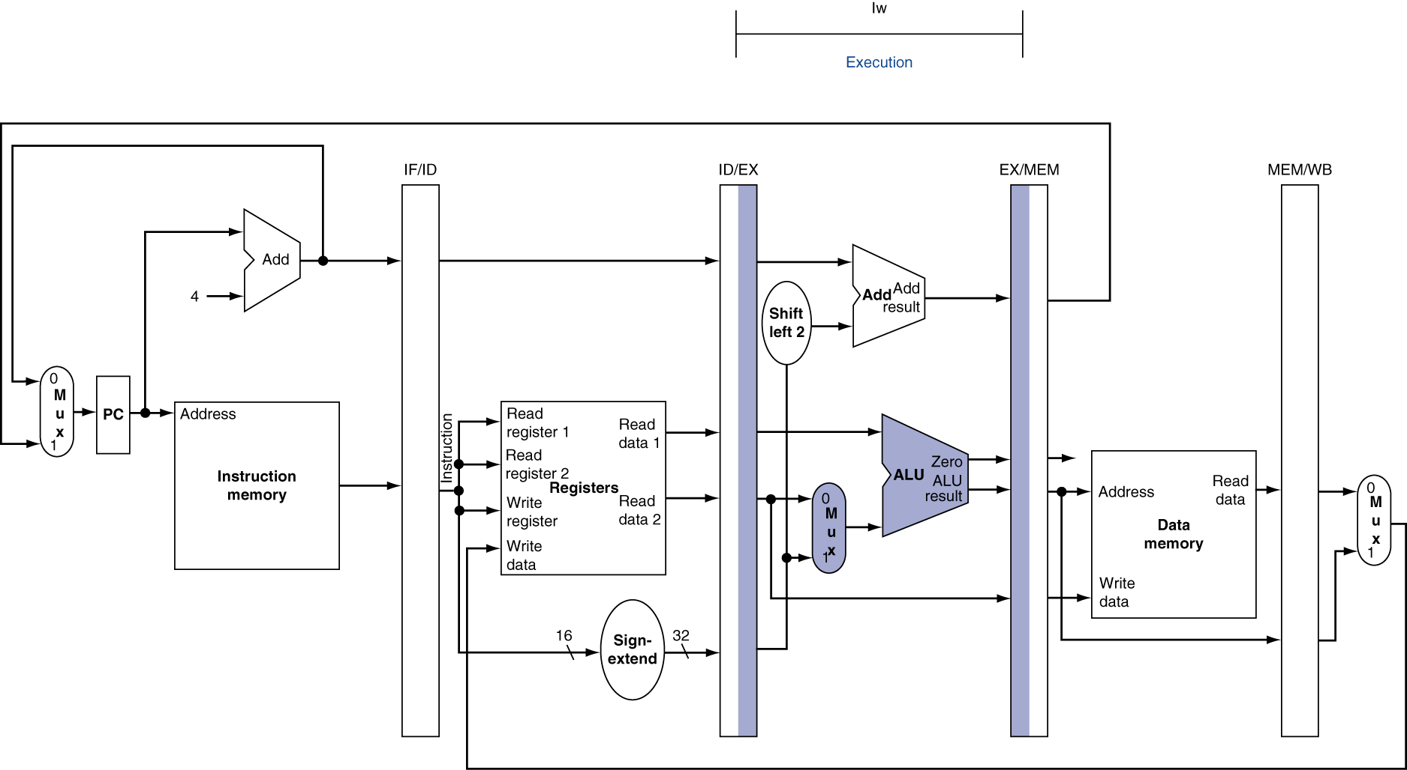
Pipeline datapath (Cont.)
Ex: lw goes through the 5 stages of pipelined execution (Cont.)
Execute or address calculation (EX)
Using the ALU to calculate the load address
To add the contents of register 1 and the sign-extended immediate from the ID/EX
ALU result is placed in the EX/MEM

Slide 50
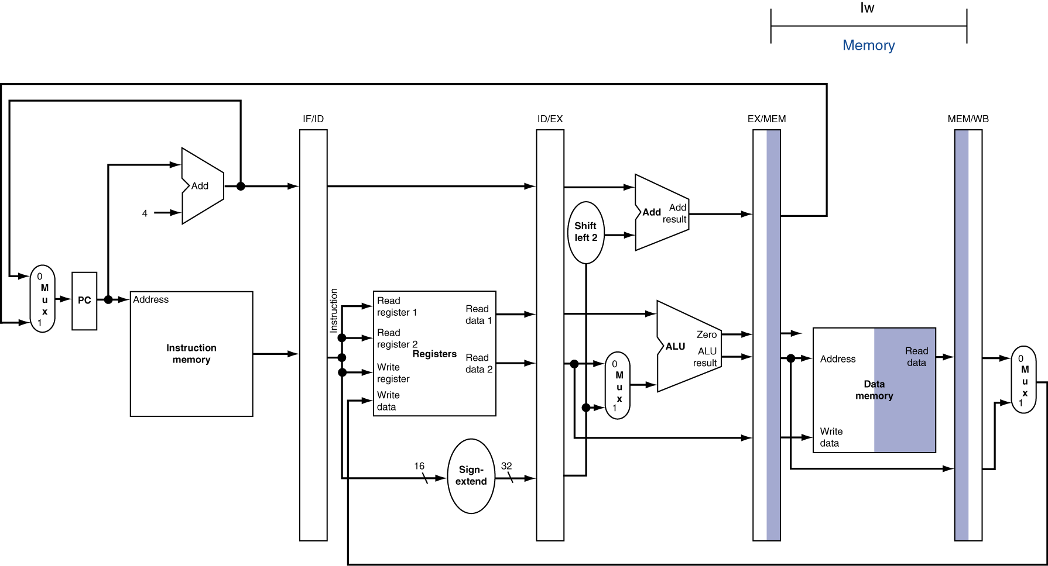
Pipeline datapath (Cont.)
Ex: lw goes through the 5 stages of pipelined execution (Cont.)
Memory access (MEM)
To read the data memory using the address from the EX/MEM
To load the data into the MEM/WB

Slide 51
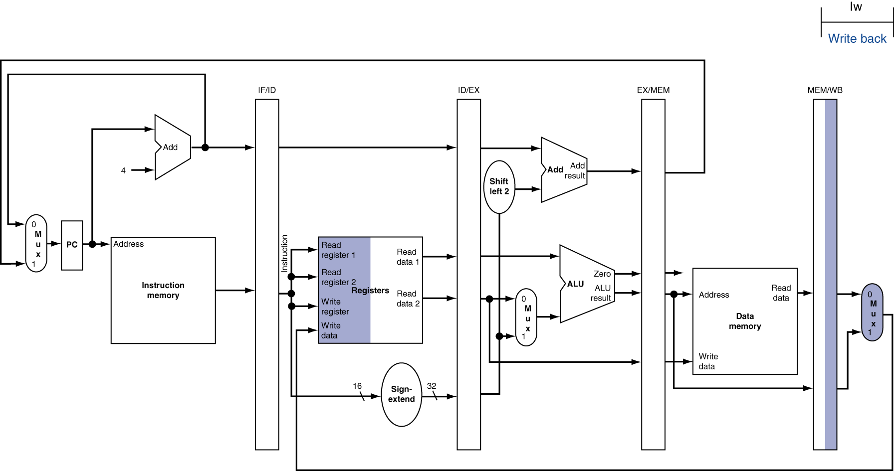
Pipeline datapath (Cont.)
Ex: lw goes through the 5 stages of pipelined execution (Cont.)
Write back (WB)
To read the data from the MEM/WB
To write the data into the register file

Slide 52
Pipeline datapath (Cont.)
Ex: sw goes through the 5 stages of pipelined execution
Fig. 4.39 and 4.40
Two key points in the pipelined datapath
To pass something from an early pipe stage to a later pipe stage, the information must be placed in a pipeline register
Otherwise the information is lost when the next instruction enters that pipeline stage
For the sw instruction, the data been stored was first placed in the ID/EX and then passed to the EX/MEM
Each logical component of the datapath can be used only within a single pipeline stage
Otherwise a structural hazard will occur
A bug in this design: the write register number of lw is not supplied!
⇒ To preserve the destination register number in lw instruction
lw must pass the write register number from the ID/EX through EX/MEM to the MEM/WB

Slide 53
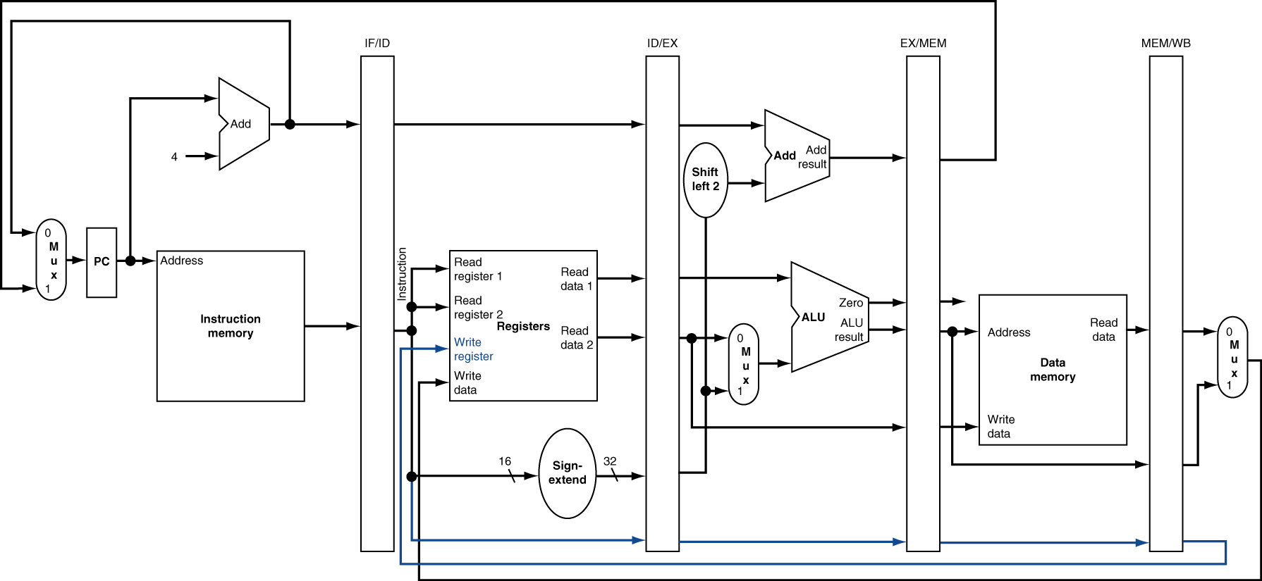
Fig. 4.41 The corrected pipelined datapath to properly handle the load instruction.

Slide 54
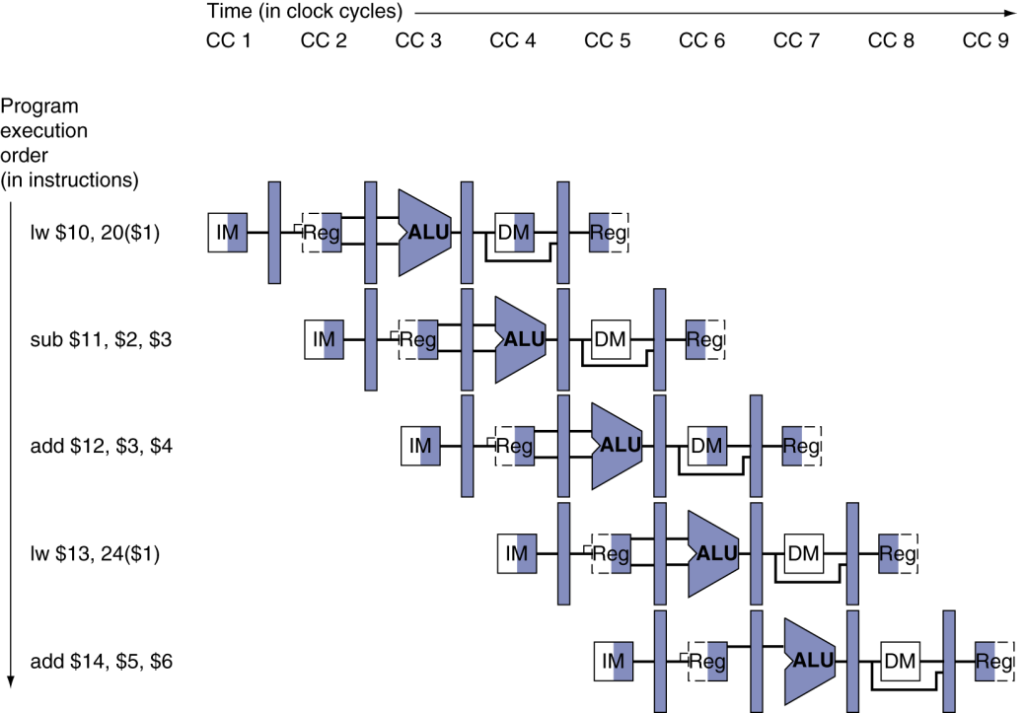
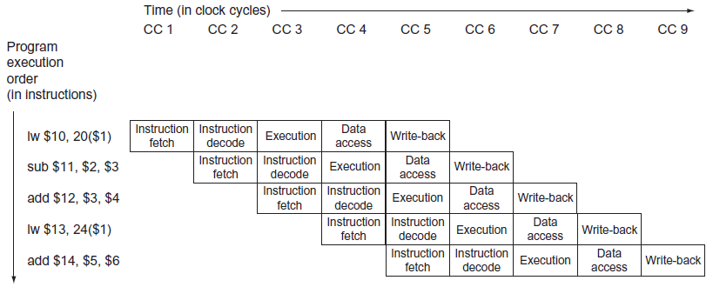
Graphically representing pipelines
Multiple-clock-cycle pipeline diagram
Simpler, do not contain all the details
Occupying the proper clock cycles
Time advances from left to right
Instructions advance from the top to the bottom
Fig. 4.43 Multiple-clock-cycle pipeline diagram of five instructions.
Fig. 4.44 Traditional multi-clock-cycle pipeline diagram of five instructions in Fig. 43.

Slide 55
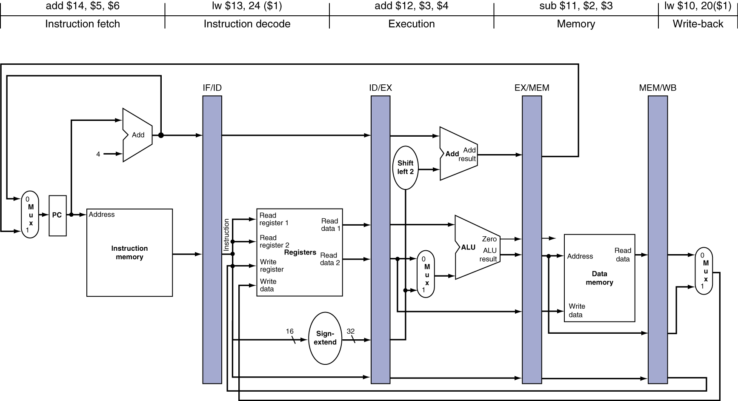
Graphically representing pipelines (Cont.)
Single-clock-cycle pipeline diagram
To show the details of what is happening within the pipeline during each clock cycle
Typically the drawings appear in groups to show pipeline operation over a sequence of clock cycles
Fig. 4.45 The single-clock cycle diagram corresponding to clock cycle 5 of the pipeline in Fig. 4.43 and Fig. 4.44.

Slide 56
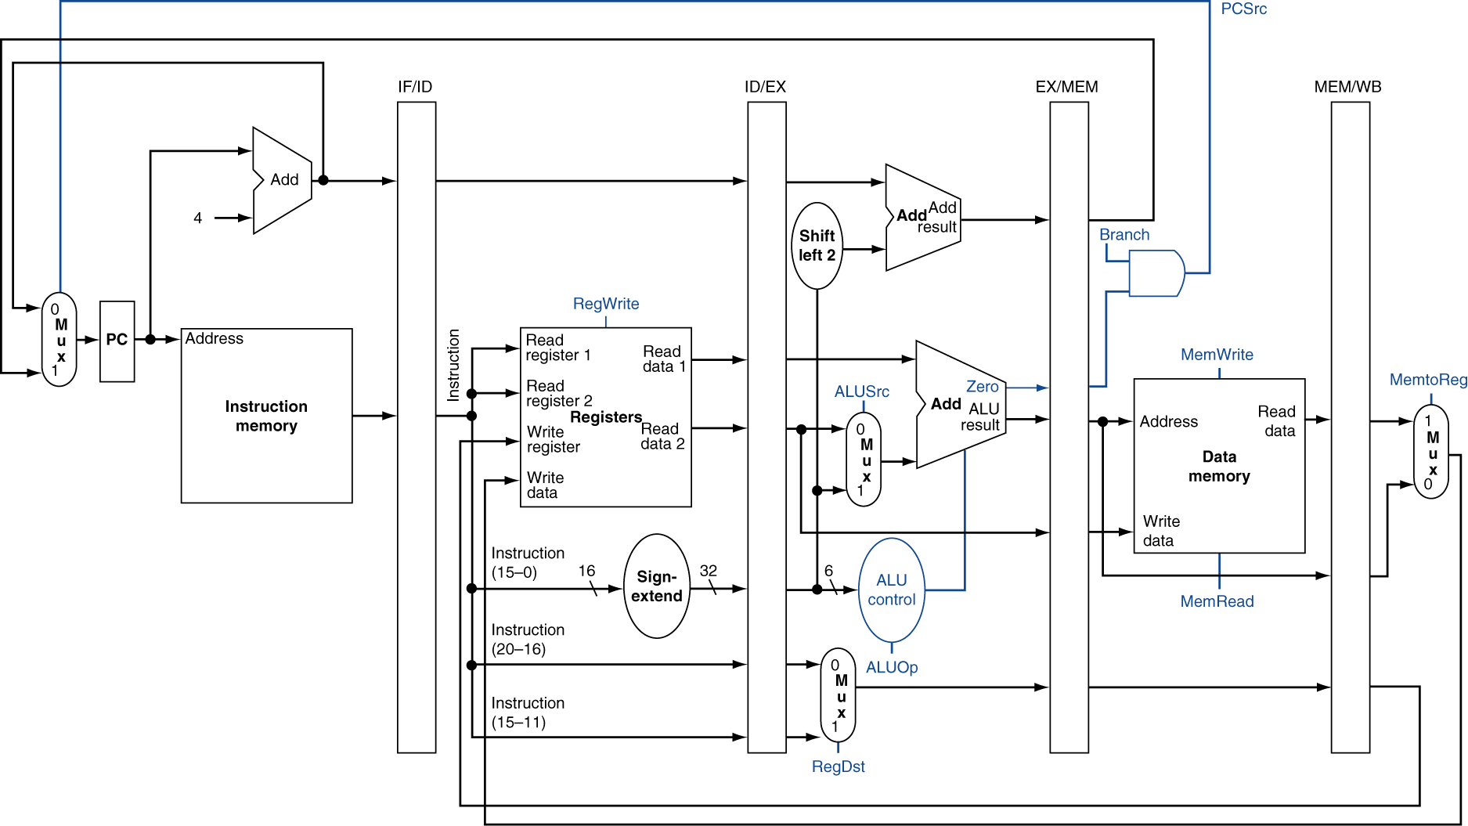
Pipelined control
To label the control lines
Similar as those used in the single-cycle implementation
No separate write signals for PC and pipeline registers
PC and pipeline registers are written on each clock cycle
Fig. 4.46 The pipelined datapath of Fig. 4.41 with the control signals identified.

Slide 57
Fig. 4.47 A copy of Fig. 4.12.
Signal name | Effect when deasserted (0) | Effect when asserted (1)
RegDst | The register destination number for the Write register comes from the rt field (bits 20:16) | The register destination number for the Write register comes from the rd field (bits 15:11)
RegWrite | None | The register on the Write register input is written with the value on the Write data input
ALUSrc | The second ALU operand comes from the second register file output (Read data 2) | The second ALU operand is the sign-extended, lower 16 bits of the instruction
PCSrc | The PC is replaced by the output of the adder that computes the value of PC + 4 | The PC is replaced by the output of the adder that computes the branch target
MemRead | None | Data memory contents designated by the address input are put on the Read data output
MemWrite | None | Data memory contents designated by the address input are replaced by the value on the Write data input
MemtoReg | The value fed to the register Write data input comes from the ALU | The value fed to the register Write data input comes from the data memory
lw
R-type
sw, beq
lw, R-type
R-type, beq
lw, sw
R-type, lw, sw, beq untaken
beq taken
R-type, sw, beq
lw
R-type, lw, beq
sw
R-type
lw
Fig. 4.48 A copy of Fig. 4.16.

Slide 58
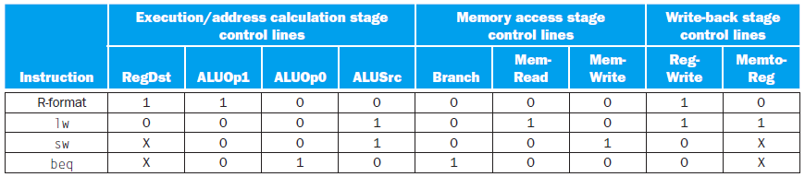
Pipelined control (Cont.)
Control lines corresponding to 5 pipeline stages
Instruction fetch & Instruction decode/register file read
No optional control lines to set
Execution/address calculation
RegDst, ALUOp, ALUSrc
Memory access
Branch, PCSrc, MemRead, MemWrite
Write back
MemtoReg, RegWrite
Fig. 4.49 The values of the control lines are the same as in Fig. 4.18, but they have been shuffled into three groups corresponding to the last three pipeline stages.

Slide 59
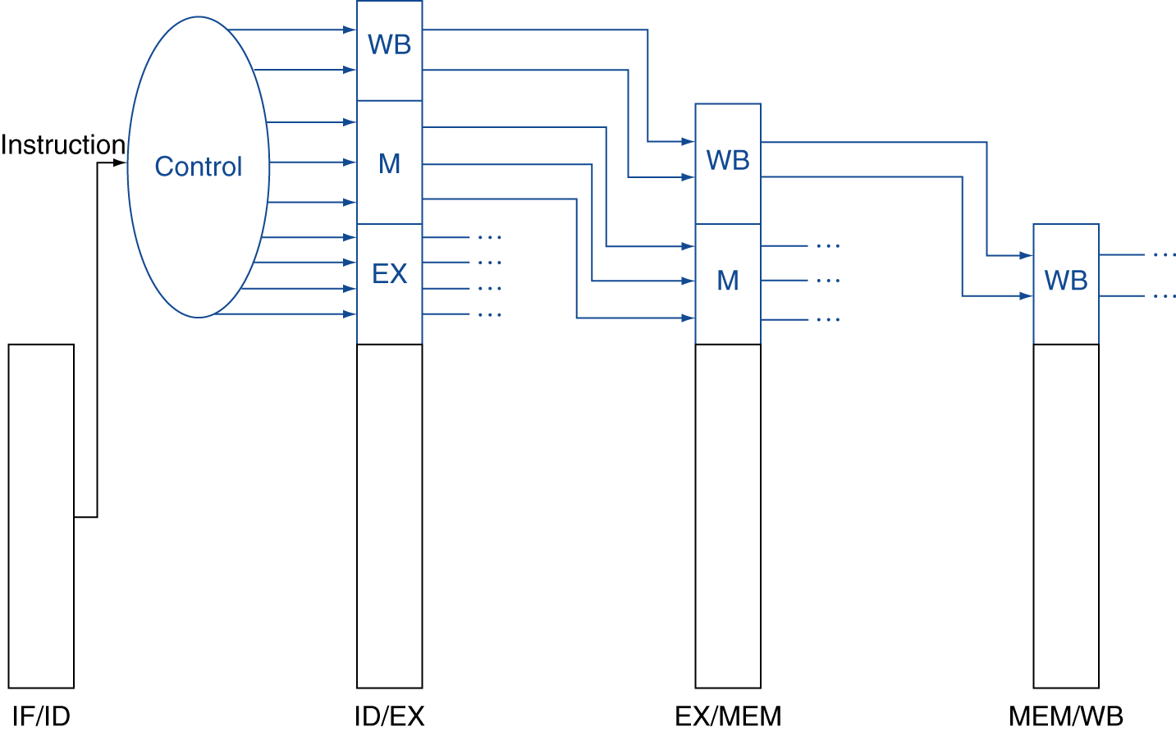
Pipelined control (Cont.)
To implement control
To extend the pipeline registers to include control information
To create the control information during instruction decode
Fig. 4.50 The control lines for the final three stages.

Slide 60
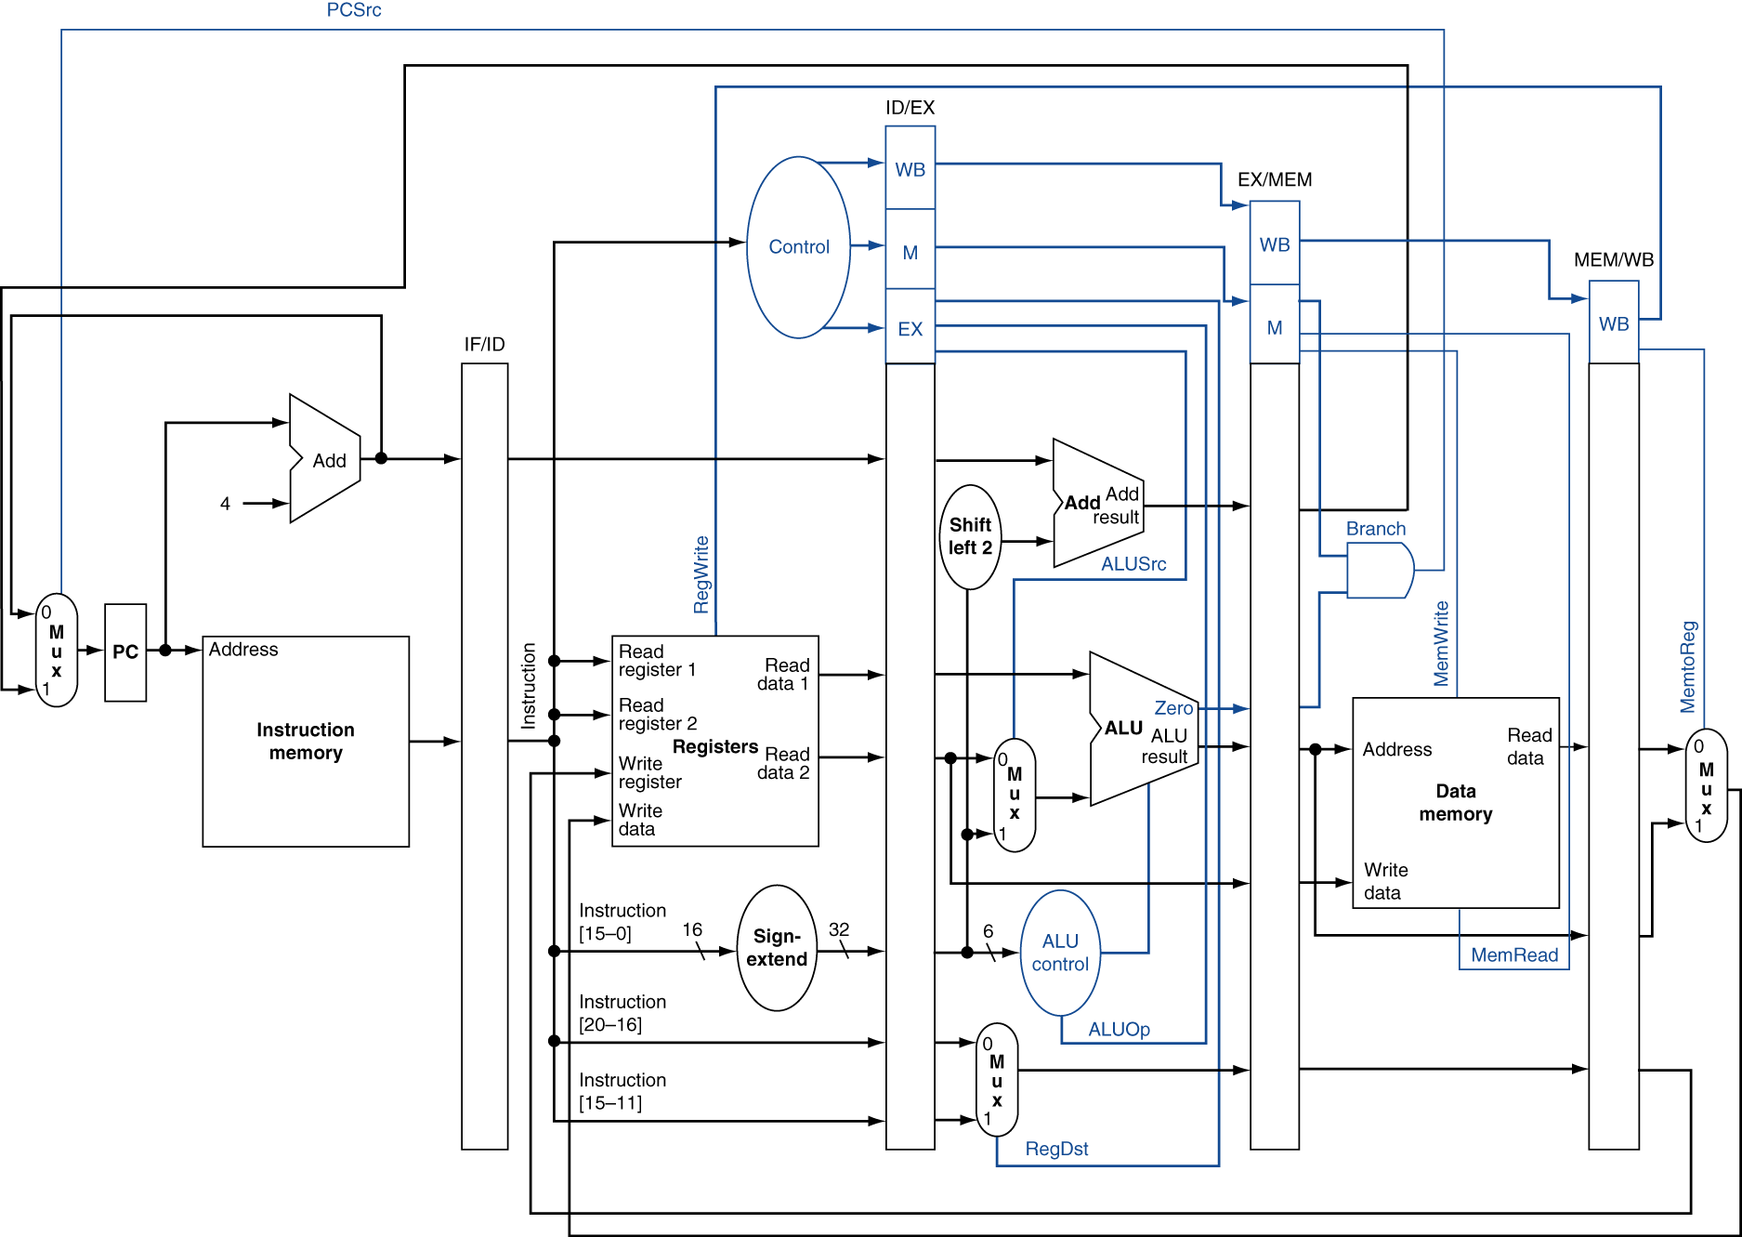
Fig. 4.51 The pipelined datapath of Fig. 4.46, with the control signals connected to the control portions of the pipeline registers.

Slide 61
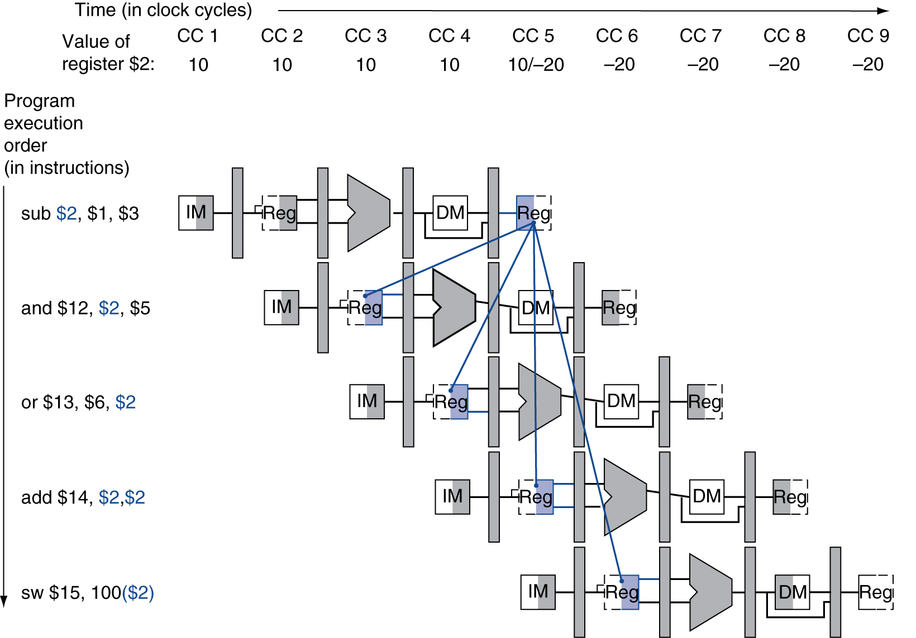
Data Hazards: Forwarding versus Stalling
Data hazards and forwarding
Example
sub $2, $1, $3
and $12, $2, $5
or $13, $6, $2
add $14, $2, $2
sw $15, 100($2)
Value of $2 changes from 10 to -20 at CC5
sw gets the correct value
Maybe add can also get the correct value
and, or get the incorrect value because dependence lines go backward in time
Fig. 4.52 Pipelined dependences in a five-instruction sequence using simplified datapaths to show the dependences.

Slide 62
Data hazards and forwarding (Cont.)
To resolve data hazards
The design of the register file hardware
Write: 1st half of the cycle Read: 2nd half of the cycle
The read delivers what is written
Forwarding
To forward the data as soon as it is available to any units that need it before it is available to read from the register file
The data is available at the end of the EX (R-type) or MEM (load) stage
To forward the data to an operation in the EX stage
ALU operation, effective address calculation
To detect data hazards
Hazard conditions
1a: EX/MEM.RegisterRd = ID/EX.RegisterRs
1b: EX/MEM.RegisterRd = ID/EX.RegisterRt
2a: MEM/WB.RegisterRd = ID/EX.RegisterRs
2b: MEM/WB.RegisterRd = ID/EX.RegisterRt
EX hazard
MEM hazard
IF ID EX MEM WB
IF ID EX MEM WB
IF ID EX MEM WB

Slide 63
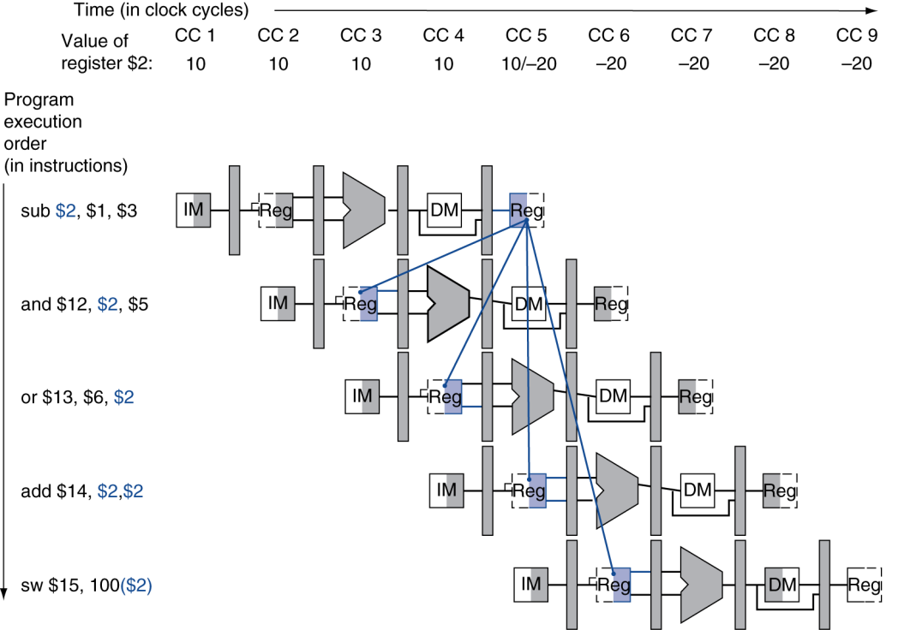
Data hazards and forwarding (Cont.)
To detect data hazards (Cont.)
Above example
Dependence #1
Hazard type 1a: EX/MEM.RegisterRd = ID/EX.RegisterRs = $2
Dependence #2
Hazard type 2b: MEM/WB.RegisterRd = ID/EX.RegisterRt = $2
Dependence #3
Not a hazard, the register file supplies the proper data
Dependence #4: no data hazard
#1
#2
#3
#4

Slide 64
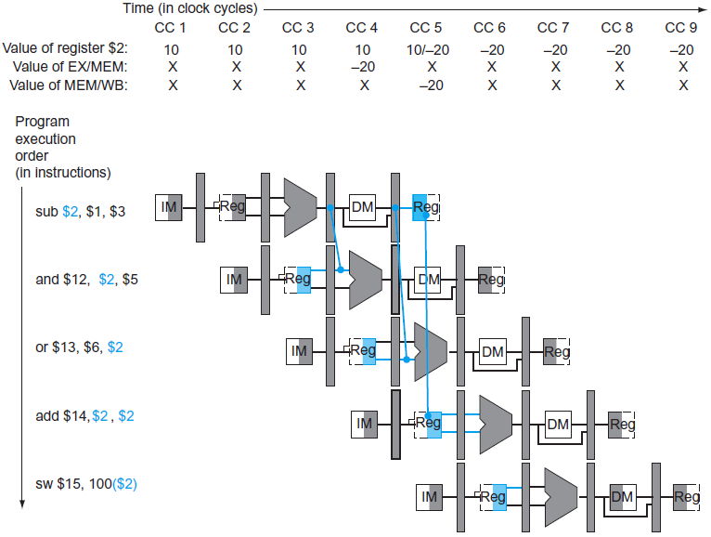
Data hazards and forwarding (Cont.)
To detect data hazards (Cont.)
Above hazard condition is inaccurate
If an instruction does not write registers, its forwarding is unnecessary
Examining the WB control field of the pipeline register during the EX and MEM stages to determine whether RegWrite is asserted
If $0 is used as destination register, its value will not be forwarded
MIPS requires that every use of $0 as an operand must yield an operand value of 0
Adding EX/MEM.RegisterRd ≠ 0 or MEM/WB.RegisterRd ≠ 0
To forward the proper data
The pipeline registers holding the
data to be forwarded
Adding multiplexors and controls
to the input of the ALU
Forwarding control is in the EX
stage
Fig. 4.53 The dependences between the pipeline registers move forward in time, so it is possible to supply the inputs to the ALU needed by the and and or instructions by forwarding the results found in the pipeline registers.

Slide 65
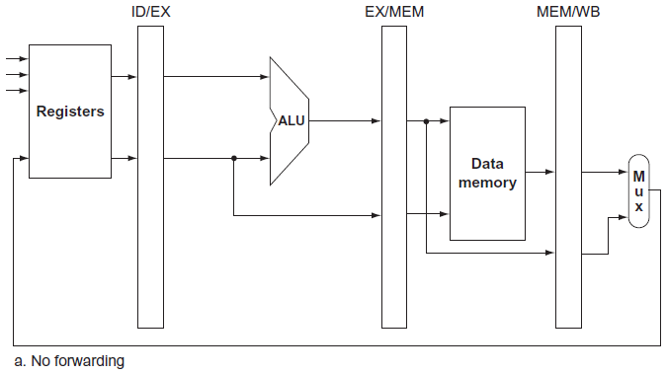


Fig. 4.54 The ALU and pipeline registers before and after adding forwarding.
Fig. 4.55 The control values for the forwarding multiplexors in Fig. 4.54.

Slide 66
Data hazards and forwarding (Cont.)
To forward the proper data (Cont.)
Hazard detection and control signals
EX hazard
if (EX/MEM.RegWrite
and (EX/MEM.RegisterRd ≠ 0)
and (EX/MEM.RegisterRd = ID/EX.RegisterRs)) ForwardA = 10
if (EX/MEM.RegWrite
and (EX/MEM.RegisterRd ≠ 0)
and (EX/MEM.RegisterRd = ID/EX.RegisterRt)) ForwardB = 10
add $2, $1, $3 IF ID EX MEM WB
add $5, $2, $4 IF ID EX MEM WB
ID/EX.RegisterRs | EX/MEM.Register.Rd
$2 | $2
ID/EX.RegisterRs = EX/MEM.RegisterRd

Slide 67
Data hazards and forwarding (Cont.)
To forward the proper data (Cont.)
Hazard detection and control signals (Cont.)
MEM hazard (original)
if (MEM/WB.RegWrite
and (MEM/WB.RegisterRd ≠ 0)
and (MEM/WB.RegisterRd = ID/EX.RegisterRs)) ForwardA = 01
if (MEM/WB.RegWrite
and (MEM/WB.RegisterRd ≠ 0)
and (MEM/WB.RegisterRd = ID/EX.RegisterRt)) ForwardB = 01
lw $2, 0($1) IF ID EX MEM WB
add $3, $4, $5 IF ID EX MEM WB
add $6, $2, $7 IF ID EX MEM WB
ID/EX.RegisterRs | EX/MEM | MEM/WB.RegisterRd
$2 |  | $2
ID/EX.RegisterRs = MEM/WB.RegisterRd

Slide 68
Data hazards and forwarding (Cont.)
To forward the proper data (Cont.)
Hazard detection and control signals (Cont.)
MEM hazard (revised)
EX and MEM hazards occurs simultaneously
⇒ Want to use the most recent value
⇒ Only forwards if EX hazard condition is not true
add $1, $1, $2 IF ID EX MEM WB
add $1, $1, $3 IF ID EX MEM WB
add $1, $1, $4 IF ID EX MEM WB
ID/EX.RegisterRs | EX/MEM.Register.Rd | MEM/WB.RegisterRd
$1 | $1 | $1
ID/EX.RegisterRs = EX/MEM.RegisterRd
ID/EX.RegisterRs = MEM/WB.RegisterRd

Slide 69
Data hazards and forwarding (Cont.)
To forward the proper data (Cont.)
Hazard detection and control signals (Cont.)
MEM hazard (revised)(Cont.)
if (MEM/WB.RegWrite
and (MEM/WB.RegisterRd ≠ 0)
and not (EX/MEM.RegWrite and (EX/MEM.RegisterRd ≠ 0)
and (EX/MEM.RegisterRd = ID/EX.RegisterRs))
and (MEM/WB.RegisterRd = ID/EX.RegisterRs)) ForwardA = 01
if (MEM/WB.RegWrite
and (MEM/WB.RegisterRd ≠ 0)
and not (EX/MEM.RegWrite and (EX/MEM.RegisterRd ≠ 0)
and (EX/MEM.RegisterRd = ID/EX.RegisterRt))
and (MEM/WB.RegisterRd = ID/EX.RegisterRt)) ForwardB = 01
if (MEM/WB.RegWrite
and (MEM/WB.RegisterRd ≠ 0)
and (EX/MEM.RegisterRd ≠ ID/EX.RegisterRs)
and (MEM/WB.RegisterRd = ID/EX.RegisterRs)) ForwardA = 01
if (MEM/WB.RegWrite
and (MEM/WB.RegisterRd ≠ 0)
and (EX/MEM.RegisterRd ≠ ID/EX.RegisterRt)
and (MEM/WB.RegisterRd = ID/EX.RegisterRt)) ForwardB = 01

Slide 70

Fig. 4.56 The datapath modified to resolve hazards via forwarding.

Slide 71

Fig. 4.57 A close-up of the datapath in Fig. 4.54 shows a 2:1 multiplexor, which has been added to select the signed immediate as an ALU input.

Slide 72

Data hazards and stalls
Forwarding cannot resolve all data hazards
An instruction tries to read a register following a lw that writes the same register
⇒ Something must stall the pipeline for the combination of lw followed by an instruction that reads its result
Fig. 4.58 A pipelined sequence of instructions.

Slide 73
Data hazards and stalls (Cont.)
Hazard detection unit
It operates during the ID stage to insert the stall between the load and its use
Condition
if (ID/EX.MemRead
and ((ID/EX.RegisterRt = IF/ID.RegisterRs)
or (ID/EX.RegisterRt = IF/ID.RegisterRt))) stall the pipeline
The instruction in the IF stage must also be stalled
To prevent the PC and IF/ID pipeline register from changing
The instruction in the IF stage will continue to be read using the same PC
The registers in the ID stage will continue to be read using the same instruction fields in the IF/ID pipeline register
Instructions in EX, MEM, WB stages: nops
An instruction that does no operation to change stage
How to insert nops
To deassert all 9 control signals in the EX, MEM, and WB stages
To change the EX, MEM, and WB control fields of the ID/EX pipeline register to 0
The changed control signals will percolate through the pipeline
No registers or memories are written if the control values are all 0

Slide 74

Data hazards and stalls (Cont.)
How to insert nops (Cont.)
Example
and becomes a nop, and all instructions following and are delayed one cycle
and and or repeat in clock cycle 4 what they did in clock cycle 3
A stall bubble delays everything behind it
Fig. 4.59 The way stalls are really inserted into the pipeline.

Slide 75

Fig. 4.60 Pipelined control overview, showing the two multiplexors for forwarding, the hazard detection unit, and the forwarding unit.

Slide 76

Control Hazards
Control hazard (branch hazard)
The delay in determining the proper instruction to fetch
An instruction must be fetched at every clock cycle to sustain the pipeline
The decision about whether to branch doesn’t occur until the MEM stage
Relatively simple and occur less frequently
Fig. 4.61 The impact of the pipeline on the branch instruction.

Slide 77
Assume branch not taken
Stalling until the branch is complete is too slow
To predict the branch will be untaken
To continue execution down the sequential instruction stream
If the branch is taken
To discard instructions that are being fetched and decoded
Execution continues at the branch target
To discard instructions (flush instructions)
To deassert all 9 control signals
To change three instructions in the IF, ID, and EX stages when the branch reaches the MEM stage
Reducing the delay of branches
To reduce the cost of the taken branch
If the branch execution is moved earlier in the pipeline, then fewer instructions need be flushed
Many branches rely only on simple tests
Do not require a full ALU operation but can be done with at most a few gates
A separate instruction that uses an ALU to perform a comparison for a more complex branch decision

Slide 78
Reducing the delay of branches (Cont.)
To move the branch decision up
Branch address calculation
To move the branch adder from the EX stage to the ID stage
To be performed for all instructions but only used when needed
Branch decision evaluation
To perform equality comparison in ID stage using XOR an OR gates
Additional forwarding and hazard detection hardware
To forward results to the equality test logic that operates during ID
A data hazard can occur and a stall will be needed
ALU instruction immediately preceding a branch
To reduce the penalty of a branch to one instruction if the branch is taken
To flush instructions in the IF stage
IF.Flush is added to zero the instruction field of the IF/ID pipeline register
The fetched instruction is transformed into a nop
add $1, $2, $3
beq $1, $4, 100
IF ID EX MEM WB
pipeline stall (nop)
IF ID EX MEM WB

Slide 79
Reducing the delay of branches (Cont.)
Example: pipelined branch
Assumption
The pipeline is optimized for branches that are untaken
Branch execution is moved to the ID stage
36 sub $10, $4, $8
40 beq $1, $3, 7 # PC-relative branch to 40 + 4 + 7 × 4 = 72
44 and $12, $2, $5
48 or $13, $2, $6
52 add $14, $4, $2
56 slt $15, $6, $7
...
72 lw $4, 50($7)
Only one pipeline bubble on a taken branch

Slide 80

Fig. 4.62 The ID stage of clock cycle 3 determines that a branch must be taken, so it selects 72 as the next PC address and zeros the instruction fetched for the next clock cycle.

Slide 81

Fig. 4.62 The ID stage of clock cycle 3 determines that a branch must be taken, so it selects 72 as the next PC address and zeros the instruction fetched for the next clock cycle.

Slide 82
Dynamic branch prediction
In an aggressive pipeline, a simple static prediction scheme may waste too much performance
Prediction of branches at runtime using runtime information
Prediction is a hint that we hope is correct
Fetching begins in the predicted direction (taken or untaken)
Branch prediction buffer (branch history table)
A small memory indexed by the low-order address bits of branch
To contain one or more bits indicating whether the branch was recently taken or not
Several branches with the same low-order address bits will share the same entry in the branch prediction buffer
Dynamic branch prediction schemes
1-bit prediction scheme
Using 1 bit to record and predict
Example: loops and prediction
Loop branch, branch taken 9 times and then untaken once
Mispredict on the first and last loop iterations
Prediction accuracy: 80%

Slide 83

Dynamic branch prediction (Cont.)
Dynamic branch prediction schemes (Cont.)
2-bit prediction scheme
Using 2 bits to record and predict
A prediction must be wrong twice before it is changed
A branch prediction buffer can be accessed during the IF stage
Predict taken: the target address can be known as early as the ID stage
Predict untaken: sequential fetching
If the prediction turns out to be wrong, the prediction bits are changed based on the prediction scheme it used
Fig. 4.63 The states in a 2-bit prediction scheme.

Slide 84

Dynamic branch prediction (Cont.)
Branch delay slot
The slot directly after a delayed branch instruction
Compilers and assemblers try to place an instruction that always executes after the branch
To make the successor instructions valid and useful
Three ways to schedule the branch delay slot
Fig. 4.64 Scheduling the branch delay slot.

Slide 85
Dynamic branch prediction (Cont.)
Branch target buffer
A structure that caches the destination PC or destination instruction for a branch
Usually organized as a cache with tags
More costly than a simple prediction buffer
Correlating predictor
Using information about both a local branch and the global behavior of recently executed branches
Greater prediction accuracy for the same number of prediction bits
Tournament branch predictor
Multiple predictors for each branch
A selection mechanism that chooses which predictor to enable for a given branch

Slide 86
Example: comparing performance of several control schemes
Problem
To compare performance for single-cycle, multicycle, and pipelined
Instruction mix
25% loads, 10% stores, 11% branches, 2% jumps, 52% ALU instructions
Functional unit times
Memory access: 200 ps ALU operation: 100 ps Register file R/W: 50 ps
Pipelined
Half of the loads are immediately followed by an instruction that uses the results
Branch delay on misprediction is 1 clock cycle
¼ branches are mispredicted
Jumps always pay 1 full clock cycle (average time is 2 clock cycles)
Solution
Single-cycle
Clock cycle: 200 + 50 + 100 + 200 + 50 = 600 ps CPI: 1
Multicycle
Clock cycle: 200 ps
CPI: 0.25 × 5 + 0.1 × 4 + 0.11 × 3 + 0.02 × 3 + 0.52 × 4 = 4.12

Slide 87
Example: comparing performance of several control schemes (Cont.)
Solution (Cont.)
Pipelined
Clock cycle: 200 ps
CPI
Loads: 0.5 × 1 + 0.5 × 2 = 1.5
Stores & ALU instructions: 1
Branches: 0.75 × 1 + 0.25 × 2 = 1.25
Jumps: 2
⇒ 0.25 × 1.5 + 0.1 × 1 + 0.11 × 1.25 + 0.02 × 2 + 0.52 × 1 = 1.17
Average instruction time
Single-cycle: 600 × 1 = 600 ps
Multicycle: 200 × 4.12 = 824 ps
Pipelined: 200 × 1.17 = 234 ps

Slide 88

Fig. 4.65 The final datapath and control for this chapter.

Slide 89

Exceptions
Preliminary
Control is the most challenging aspect of processor design
The hardest part to get right and make fast
Exception vs. interrupt
Events other than branches or jumps that change the normal flow of instruction execution
Exception
Any unexpected change in control flow without distinguishing whether the cause is internal or external
Interrupt
An exception that comes from outside of the processor
To detect exceptional conditions and taking the appropriate action is often on the critical timing path of a processor

Slide 90

How exceptions are handled in the MIPS architecture
Execution of an undefined instruction, an arithmetic overflow
When an exception occurs
To save the address of the offending instruction in the exception program counter (EPC)
To determine where to restart the execution of the program
To transfer control to the operating system at some specified address
To provide some service to the user program
To take some predefined action in response to an overflow
To stop the execution and report an error
To terminate or continue the program
To communicate the reason for an exception
Using a Cause register to indicate the reason for the exception
Vectored interrupts
The address to which control is transferred is determined by the cause of the exception
The addresses are separated by 32 bytes or eight instructions
When the exception is not vectored
A single entry point for all exceptions
The OS decodes the status register to find the cause

Slide 91
How exceptions are handled in the MIPS architecture (Cont.)
To implement the exception system used in the MIPS architecture
The single entry point being the address 80000180_{hex}
EPC register
A 32-bit register used to hold the address of the affected instruction
Cause register
A 32-bit register used to record the cause of the exception
Ex: 10: undefined instruction 12: arithmetic overflow
Exceptions in a pipelined implementation
To treat exceptions as another form of control hazard
Steps to deal with exception (using an arithmetic overflow as an example)
To transfer control to the exception routine immediately
To flush instructions that follow the instruction caused exception
IF stage
To zero the instruction field of the IF/ID pipeline register (turning into a nop instruction)
Similar as steps for branch misprediction
ID stage
To zero control signals using the multiplexor already in the ID stage
Similar as steps for stall
ID.Flush is ORed with the stall signal from the hazard detection unit

Slide 92
Exceptions in a pipelined implementation (Cont.)
Steps to deal with exception (using an arithmetic overflow as an example) (Cont.)
To flush instructions that follow the instruction caused exception (Cont.)
EX stage
EX.Flush is added to cause new multiplexors to zero the control lines
To prevent the instruction in the EX stage from writing its result in the WB stage
To start fetching instructions from location 80000180_{hex}
To add an additional input to the PC multiplexor that sends 80000180_{hex} to the PC
To stop or complete the instruction that caused the exception
To stop execution in the middle of the instruction if necessary
If the instruction requires to be eventually completed, the instruction will be restarted from the beginning after the exception is handled
To save the address of the offending instruction in the EPC register
In reality it saves the address +4
The exception handling routine must first subtract 4 from the saved value

Slide 93

Fig. 4.66 The datapath with controls to handle exception.

Slide 94
Exceptions in a pipelined implementation (Cont.)
Example: exception in a pipelined computer
Instruction sequence
40_{hex} sub $11, $2, $4
44_{hex} and $12, $2, $5
48_{hex} or $13, $2, $6
4C_{hex} add $1, $2, $1
50_{hex} slt $15, $6, $7
54_{hex} lw $16, 50($7)
…
Instructions to be invoked on an exception
80000180_{hex} sw $25, 1000($0)
80000184_{hex} sw $26, 1004($0)
…
Assume an overflow exception occurs in the add instruction

Slide 95

Fig. 4.67 The result of an exception due to arithmetic overflow in the add instruction.

Slide 96

Fig. 4.67 The result of an exception due to arithmetic overflow in the add instruction.

Slide 97
Exceptions in a pipelined implementation (Cont.)
Multiple exceptions can occur simultaneously
To prioritize the exceptions (by the hardware)
I/O device requests and hardware malfunctions are not associated with a specific instruction
The implementation has some flexibility as to when to interrupt the pipeline
To match the exception to the instruction
The EPC register captures the address of the interrupted instructions
The Cause register records all possible exceptions in a clock cycle
Knowing in which pipeline stage a type of exception can occur
An undefined instruction is discovered in the ID stage
Invoking the operating system occurs in the EX stage
The difficulty of always associating the correct exception with the correct instruction in pipelined computers
Imprecise interrupt (imprecise exception)
An interrupt or exception that is not associated with the exact instruction that was the cause the interrupt or exception
The operating system will determine which instruction caused the problem
Precise interrupt (precise exception)
An interrupt or exception that is always associated with the correct instruction

Slide 98
The hardware and the operating system must work in conjunction to deal with exceptions
Hardware
To stop the offending instruction
Let all prior instructions complete and flush all following instructions
To set registers EPC and Cause
To jump to a prearranged address
Operating system
To look at the cause of the exception and act appropriately
For an undefined instruction, hardware failure, or arithmetic overflow
To kill the program and return an indicator of the reason
For an I/O device request or an OS service call
To save the state of the program
To perform the desired task
To restore the program to continue execution
To run another task in the case of I/O device requests
The most frequent exceptions
Page faults and TLB exceptions

Slide 99


Parallelism via Instructions
Fig. 4.68 Static two-issue pipeline in operation.
Fig. 4.69 A static two-issue datapath.

Slide 100


Fig. 4.70 The scheduled code as it would look on a two-issue MIPS pipeline.
Fig. 4.71 The unrolled and scheduled code of Fig. 4.70 as it would look on a static two-issue MIPS pipeline.

Slide 101

Fig. 4.72 The three primary units of a dynamically scheduled pipeline.

Slide 102

Fig. 4.73 Record of Intel Microprocessors in terms of pipeline complexity, number of cores, and power.

Slide 103

Real Stuff: The ARM Cortex-A8 and Intel Core i7 Pipelines
Fig. 4.74 Specification of the ARM Cortex-A8 and the Intel Core i7 920.

Slide 104


Fig. 4.75 The A8 pipeline.
Fig. 4.76 CPI on ARM Cortex A8 for the Minnespec benchmarks, which are small versions of the SPEC2000 benchmarks.

Slide 105

Fig. 4.77 The Core i7 pipeline with memory components.

Slide 106

Fig. 4.78 CPI of Intel Core i7 920 running SPEC2006 integer benchmarks.

Slide 107

Fig. 4.79 Percentage of branch midpredictions and wasted work due to unfruitful speculation of Intel Core i7 920 running SPEC2006 integer benchmarks.

Slide 108
Fallacies and Pitfalls
Fallacies
Pipelining is easy
Correct pipeline execution is very subtle
The Verilog to describe a pipeline like that in the Intel Core i7 will be thousands of lines
Pipelining ideas can be implemented independent of technology
The delayed branch is now redundant with longer pipelines, superscalar execution, and dynamic branch prediction
In the early 1990s
Dynamic pipeline scheduling took too many resources and was not required for high performance
As transistor budgets continued to double due to Moore’s Law
Logic became much faster than memory
Multiple function units and dynamic pipelining made more sense
Today
Concerns about power are leading to less aggressive designs

Slide 109
Pitfalls
Failure to consider instruction set design can adversely impact pipelining
Many difficulties of pipelining arise because of instruction set complications
Widely variable instruction lengths and running times
Can lead to imbalance among pipeline stages and severely complicated hazard detection
Solution: micro-operations and micro-pipelined scheme
Sophisticated addressing modes
Addressing modes that update registers complicate hazard detection
Addressing modes that require multiple memory accesses substantially complicate pipeline control

